Slide 1


Christian
Ethics

Slide 2
What Makes Right acts right?

Slide 3
What makes Right Acts Right?
Pleasure or what feels right?
Power, might or force?
Wealth or land ownership?
Family, tribe, culture or heritage?
Natural Law – the rights of nature?
Evolution – right of the fittest?
National origin or boundaries?
Group or Political Party?
Majority or Minority?
Historical and/or Legal and/or Case Precedent?
A calculation of ends and the greatest happiness?
The means being justified?
Social contract?
Any religious theory of the right?

Slide 4
Is Christianity merely “a” viable option among competing ethical options?
Or, is Christianity exclusively the way, the truth, and the life?

Slide 5
How are moral claims justified or denied?
Is morality merely subjective? Or, is morality objective?
Are some moral claims absolute and universal?
Can there be certainty in moral claims?

Slide 6
Foundations of Christian Ethics
Truth is real and can be known
God Exists
The Bible is Inspired of God
Jesus is the Son of God

Slide 7
Coming to a knowledge of the Truth

Slide 8

Rational Basis of Ethics
Rationality (being rational)
  the law of rationality states “we ought to justify our conclusions by adequate evidence” ²
  differs from rationalization, which is self justification. ³
^{Luke 10:29}

Slide 9
Rational Basis of Ethics
Rationality (being rational)
  What counts as “adequate evidence”?²
    Mathematics – conclusive proof counts as adequate evidence.
    Weather Prediction- probability counts as adequate evidence
    In Law, three different standards of proof:
      a preponderance of evidence
      clear and convincing evidence
      beyond a reasonable doubt

Slide 10

Rational Basis of Ethics
Irrationality – is to draw conclusions that are not warranted by adequate evidence
  Fail mathematically.
  Fail tests of probability.
  Fail to meet legal thresholds
Psychiatric/ Psychological Irrational – inadequate processing, emotional distress, cognitive deficit.

Slide 11
Evasions of the Law of Rationality⁴
Appeals to Authority – E.g. Michael Jordan wears HANES
Appeals to Emotion – “I cannot bear to think it untrue”
Argumentum ad Hominem – directed at the man
Argumentum ad Ignorantiam (appeal to ignorance) - it’s true because you can not disprove it.

Slide 12
Evasions of the Law of Rationality⁴
Begging the Question – the conclusion merely restates the evidence. E.g. Ethics is good b/c it is good.
Diverting the Issue – Evidence is offered for a different proposition than the present.
Special Pleading – “cherry picking” using only evidence that is favorable to the conclusion we want.

Slide 13
First Principles

Slide 14
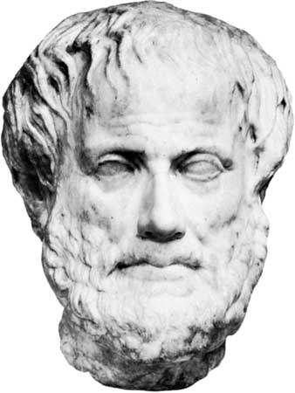
Laws of Thought (Aristotle)⁵
Law of Identity (A = A) “it is what it is”
  For things: “a term retains identical meaning”
    a dog is a dog.
  For propositions: if a proposition is true, it is true.
    It’s true “for all persons, in all times, and in all places.”
    Example: “It is wrong to torture children.”
Notes:
Image Source: http://media-2.web.britannica.com/eb-media/73/5873-004-E5A0EFE3.jpg, last accessed 8-25-10.

Slide 15
Laws of Thought (Aristotle) ⁵
Law of Excluded Middle (A or not-A) “it is what it is or isn’t”
  For things: “anything is A or its contradictory.” The car is red or not red, where red is precisely defined.
  For propositions: A proposition is either true or false.
    Example: There is no middle ground. The proposition “it is wrong to torture children” is either true or not true. This law excludes the possibility that “it may be wrong to torture children.”
  NOTE
    Precision in definition is vital here.
    This law identifies a level of certainty in what is being claimed.
    This is not to say that there are not differences of degree (E.g. body temperature). This law is axiomatic. Either you are 98.6 degrees F or not.

Slide 16
Laws of Thought (Aristotle) ⁵
Law of Contradiction (Non-Contradiction) “can’t be it is what it is and what it isn’t”
  For Things: “Nothing can be both A and the contradictory of A.”
  For Propositions: “no proposition can be both true and false, in the same respect.”
    Example: It cannot be both wrong and not wrong to torture children.

Slide 17
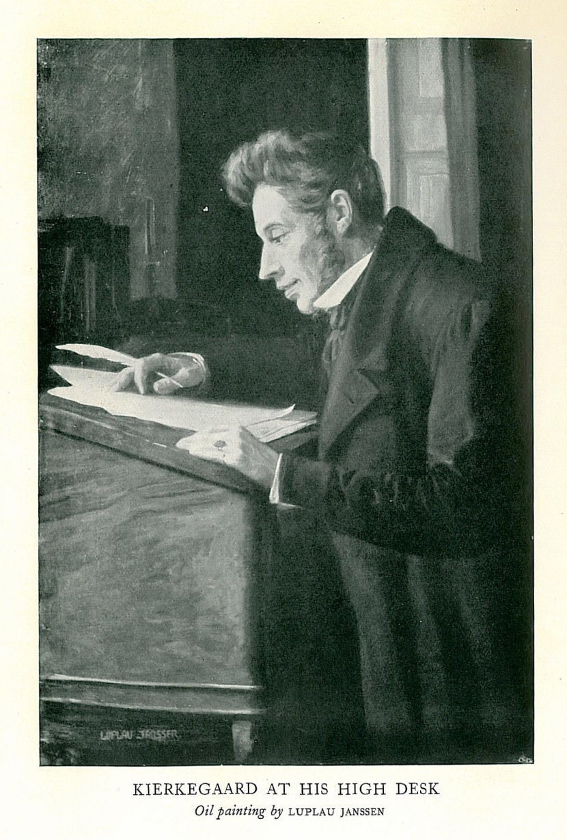
Soren Kierkegaard
“I want a truth for which I can live and die.” from his Journals at age 20
Notes:
Image from http://marcus.whitman.edu/~paulusmj/kierkegaard.jpg, last accessed September 10, 2009.

Slide 18
Philosophical truth questions
(Steven Goldman, Science Wars: What Scientists Know and How they Know It, Great Courses, 14).
Is this truth timeless? (Eccl. 3:1-8)
It is universal? Does it apply to all people in all places? (2 Kings 5:10 vs. John 8:24)
Is it necessary?
  Archeology as a proof for inspiration is necessary, but not sufficient for establishing the Bible as Divine.
  A document could be validated archeologically yet be a work of fiction.
Is it certain? (Luke 1:4, Acts 2:36, 17:31)

Slide 19
Moral Principle of Honesty and Veracity
Veracity –
  1. Truthfulness <the witness's fraud conviction supports the defense's challenge to his veracity>.
  2. Accuracy <you called into question the veracity of Murphy's affidavit>. — veracious (Black’s Law Dictionary, 2009).
The truth of God and the Bible are ultimate epistemological truths – we can know!
The truth of Jesus Christ is our ultimate existential example – we can live like Him!

Slide 20
Moral Principle of Honesty and Veracity
God/Bible/Jesus Christ – Epistemic and Existential
  Jesus “full of grace and truth” (John 1:14)
  Jesus is “the way, the truth, and the life” (John 14:6)
  God’s word sets apart (sanctifies); God’s word is truth (John 17:17)
  We can know truth (John 8:32)
  Spirit of truth (HS) guides into all truth (John 16:13)
  “love rejoices with truth” (1 Cor. 13:6)
  Word of truth = the gospel (Col. 1:5)

Slide 21
Stopped

Slide 22
Moral Argument for the Existence of God
Objective evil is real and exists.
If objective evil exists, then objective good exists.
If objective evil and objective good exist, then an objective standard exists.
If an objective standard exists, then an objective standard Giver exists.

Slide 23
Moral Principle of Honesty and Veracity
Veracity –
  1. Truthfulness <the witness's fraud conviction supports the defense's challenge to his veracity>.
  2. Accuracy <you called into question the veracity of Murphy's affidavit>. — veracious (Black’s Law Dictionary, 2009).
The truth of God and the Bible are ultimate epistemological truths – we can know!
The truth of Jesus Christ is our ultimate existential example – we can live like Him!

Slide 24
Truth is Not Necessarily Determined by:
Majority
  10 spies were wrong (Num. 13:31, Ex. 23:2)
Minority
  Peter and Barnabas were wrong in their bias toward Jews (Gal. 2:7-8)
History
  Truth is revealed in history
  Historical truth is just as true as recent truth
  Truth isn’t truer because it happened more recently

Slide 25
Truth is Not Necessarily Determined by:
Personal Experience
  Deceived or duped by magic or slight of hand
  Psychosomatic Event – like a physical reaction to plastic flowers

Slide 26
Correspondence Theory of Truth
Historically, the correspondence theory of truth is suggested in the writings of Plato (Sophist), Aristotle’s (Categories and Metaphysics); It echoes down the centuries through St. Thomas Aquinas, William of Ockham, and more modernly G.E. Moore. ⁶
What is the Correspondence Theory of Truth?
  “According to the correspondence theory truth consists in correspondence to the facts. A truth-bearer (say, the proposition that snow is white) is true if and only if it corresponds to a fact (that snow is white). Broadly speaking, truth is a relational property between truth-bearers on the one side and the world on the other.” ⁶

Slide 27
Correspondence Theory of Truth^{6,7}
Example
  If I make the claim that there are 16 students in the class, this is true, if and only if, it corresponds with reality that there are indeed 16 students in the class. If there are 18 students, then my claim does not correspond to reality and is therefore false.
  Mathematical Correspondence

Slide 28
Truth Corresponds
Genesis 42:16 Send one of you, and let him bring your brother, while you remain confined, that your words may be tested, whether there is truth in you. Or else, by the life of Pharaoh, surely you are spies."

Slide 29
Truth Corresponds
Deuteronomy 18:22 when a prophet speaks in the name of the LORD, if the word does not come to pass or come true, that is a word that the LORD has not spoken;

Slide 30
Coherence Test
Things that cohere, agree, connect, are consistent (Webster)
Coherence is a negative test for truth, not a positive one

Slide 31
Nature of Truth
Truth is Objective – “the faith”
  Jude 1:3 ³ Beloved, although I was very eager to write to you about our common salvation, I found it necessary to write appealing to you to contend for the faith that was once for all delivered to the saints.
Our Response – Subjective – “your faith”
  2 Thessalonians 1:3 ³ We ought always to give thanks to God for you, brothers, as is right, because your faith is growing abundantly, and the love of every one of you for one another is increasing.

Slide 32
Subjective Response in Faith
Note these Subjective Responses to the Objective Faith
  Matt. 7:7-8 - Ask, Seek, and Knock – subjective responses
  John 7:17 If anyone’s will is to do God’s will, he will know whether the teaching is from God or whether I am speaking on my own authority.
    Personal Subjective Response of Knowledge upon Receiving Objective Truth/Knowledge (John 7:17, Rom. 10)
  James 1:5 If any of you lacks wisdom, let him ask God, who gives generously to all without reproach, and it will be given him.

Slide 33
Subjective Response in Faith
“The Christian ideal has not been tried and found wanting. It has been found difficult; and left untried.” GK Chesterton, What’s Wrong with the World
Faith is the result/ product of proper application of truth, not I believe, therefore its true
John 4:43-54
  Vs. 48 – “you all” (NAS)
  We live in a world that says “seeing is believing”
    Jesus said “go” and he eventually would see
  Christianity experience - “believing is seeing” (Acts 28:27-28)

Slide 34
Subjective Response in Faith
We live in a testimonial/ anecdotal world (Social Media)
What is the role of personal experience?
  Historical or Contemporary (cf. Acts 1:8)?
  The OT and NT are full of first-person Divine encounters that validate the corpus/ totality of the truth presented (1 Cor. 14:37)
  Yours/ My Contemporary Personal Religious Experience is not a Source of Divine Authority. Scripture is (2 Tim. 3:16-17, Jude 1:3).
    Therefore, experience can be meaningful, yet not authoritative

Slide 35
Subjective Response in Faith
Yet, is our own personal experience meaningless?
  Certainly not to us (Heb. 11:6). But what about to others?
  Is a balance to be found between, on the one-hand rejecting current uninspired witnessing plus rejecting personal testimonials, and on the other hand understanding that faith is propagated “from faith for (ESV)/ to (KJV) faith” (Rom. 1:16-17, Rom. 10)?

Slide 36
Nature of Truth
Some Truths are Without Exception – Absolute
  God Exists, Jesus is God’s Son, Bible is Inspired
  Matt. 22:37-39
Some Truths are Instrumental (Relative)
  Can I sing this song? Can I eat this meat? - It depends on various contingencies
    1 Cor. 10:23, Rom. 14, 1 Cor. 8
  Other passages with relative words (e.g. more, less, greater, lesser) – Ecc. 7:26, 10:10, Matt. 10:15
  Note: Don’t confuse the circumstantial with Relativism

Slide 37
Nature of Truth and the 10 Commandments
Prescriptive – Ought
  4th – Keep the Sabbath
  5th – Honor Father and Mother
Proscriptive – Ought not
  All other 8 Commandments

Slide 38
Nature of Truth and Time
Immediate - Present
  Acts 2:38 And Peter said to them, "Repent and be baptized every one of you in the name of Jesus Christ for the forgiveness of your sins, and you will receive the gift of the Holy Spirit.
Retrospective - Past
  1 John 1:3 that which we have seen and heard we proclaim also to you, so that you too may have fellowship with us; and indeed our fellowship is with the Father and with his Son Jesus Christ.
    “have seen” and “heard” – both are perfect tense, meaning completed in the past with continuing results

Slide 39
Nature of Truth and Time
Prospective – Future
  Acts 10:42-43 And he commanded us to preach to the people and to testify that he is the one appointed by God to be judge of the living and the dead. ⁴³ To him all the prophets bear witness that everyone who believes in him receives forgiveness of sins through his name."

Slide 40
Truth Can Be
Known (John 8:32)
Tested, Proven (1 Thess. 5:21)
Persuasive (2 Cor. 5:11)
Chosen (Josh. 24:15)
Relative to time: past/ retrospective, present/ immediate, or future/prospective (Rom. 10:9-10, Acts 2:38, Acts 10:42-43)
Prescriptive (4th and 5th Commandment) – Ought
Proscriptive (1-3, 6-10 Commandments) - Prohibits
Certain (Luke 1:3-4, Acts 2:36)
Unrevealed (Col. 1:26)
Revealed (Heb. 1:1-2)
Hidden (Matt. 5:15)

Slide 41
Nature of truth
Truth is Discovered (John 8:32)
Truth is Unchanging (Heb. 13:8)
Beliefs Cannot Change a Fact (1 Cor. 10:15)
Truth is not changed by the character or attitude of one professing it (Matt. 27:4, Luke 22:57).
All truths are absolute truths (1 Cor. 15:3-4)
Geisler and Turek, I Don’t Have Enough Faith To Be An Atheist

Slide 42


!!! Big Difference !!!
I believe, therefore it is true (Faith Truth)
  Test the spirits (1 John 4:1)
It is true, therefore I believe (Truth Faith)
  Faith comes from hearing (Rom. 10:17)

Slide 43
Our Response to Truth
We Can Be Certain
  Theophilus
    Luke 1:3-4 ³ it seemed good to me also, having followed all things closely for some time past, to write an orderly account for you, most excellent Theophilus, ⁴ that you may have certainty concerning the things you have been taught.
    Acts 2:36 Let all the house of Israel therefore know for certain that God has made him both Lord and Christ, this Jesus whom you crucified."

Slide 44
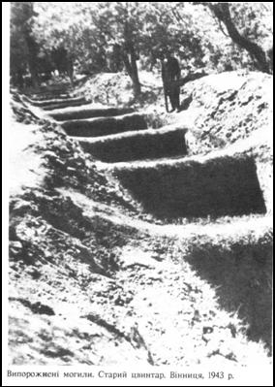
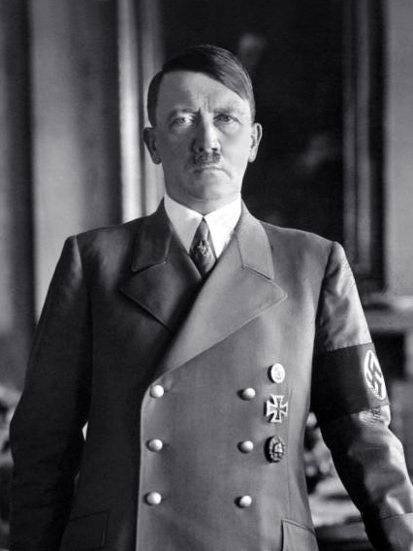
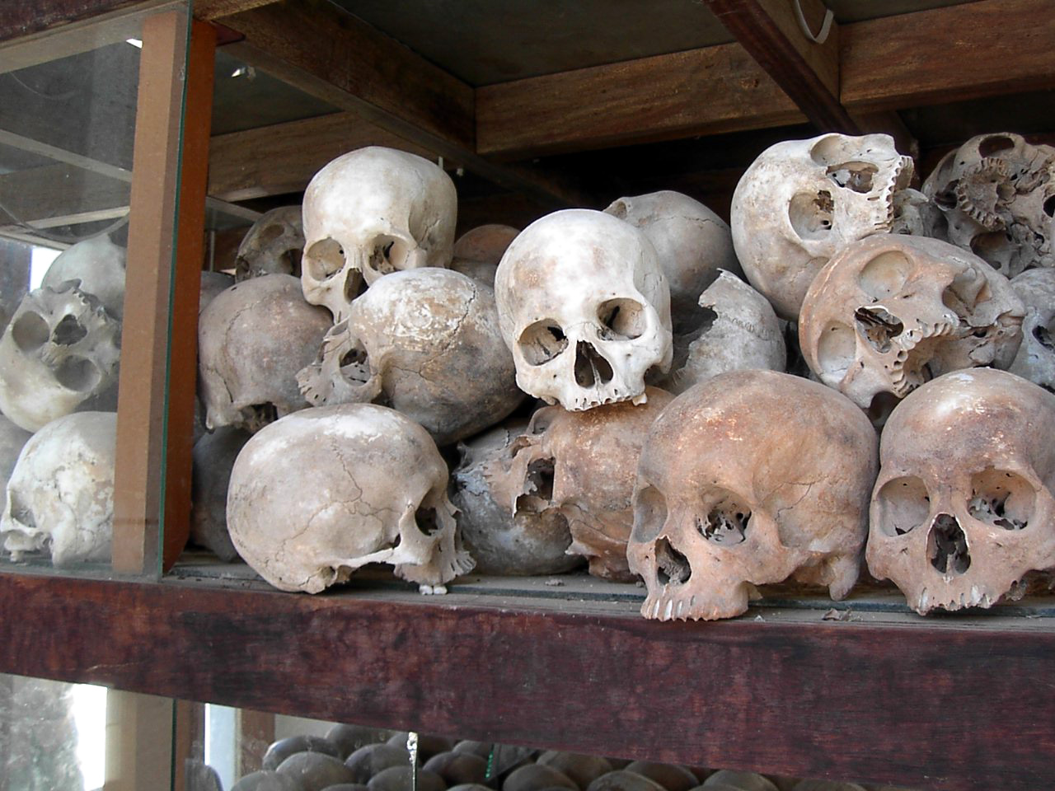
Real Evil?
Stalin’s Part in Killing 9-11,000 Ukranians (Vinnytsia Massacre), totaling 15 million
Pol Pot and Khmer Rouge
1-3 Million
Hitler - 6 Million
https://commons.wikimedia.org/w/index.php?curid=5780403, Khmer Rouge: By Anonymous - English Wikipedia[1]; <http://www.adam-carr.net/travelindex13.html>, Public Domain, https://commons.wikimedia.org/w/index.php?curid=1767288

Slide 45
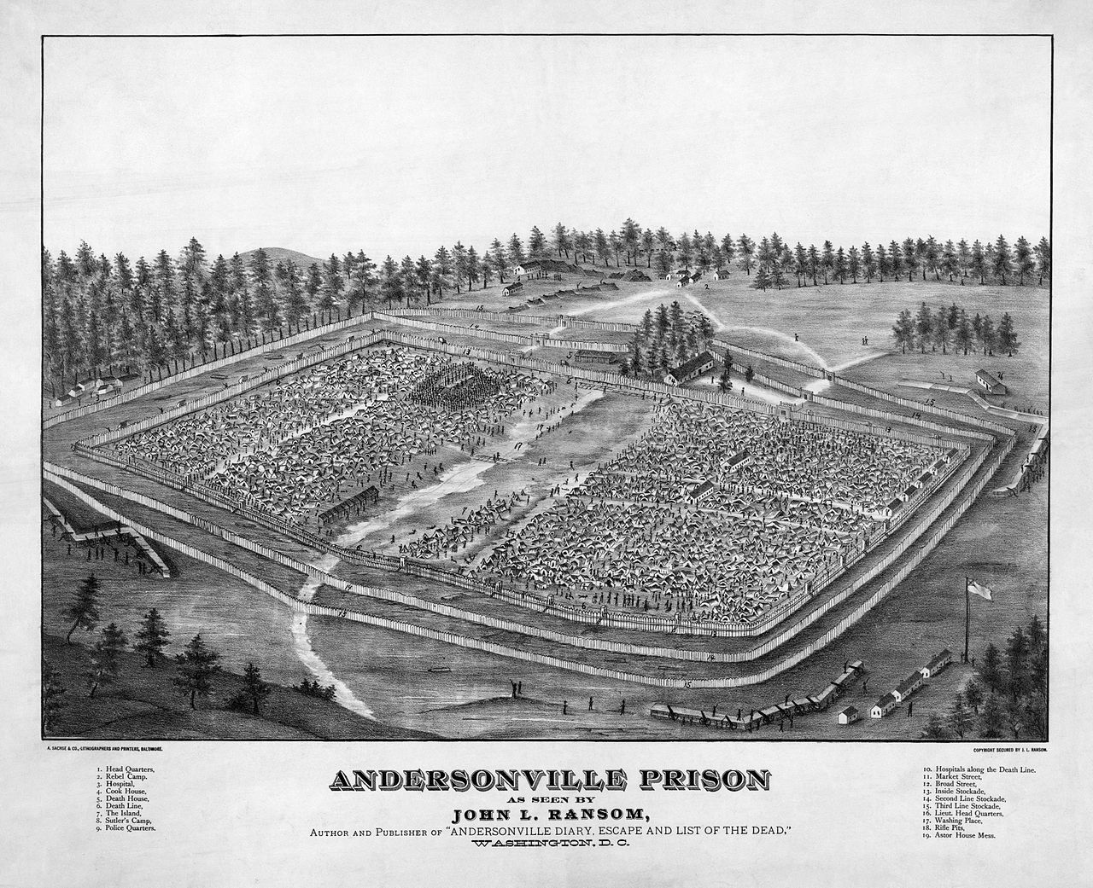
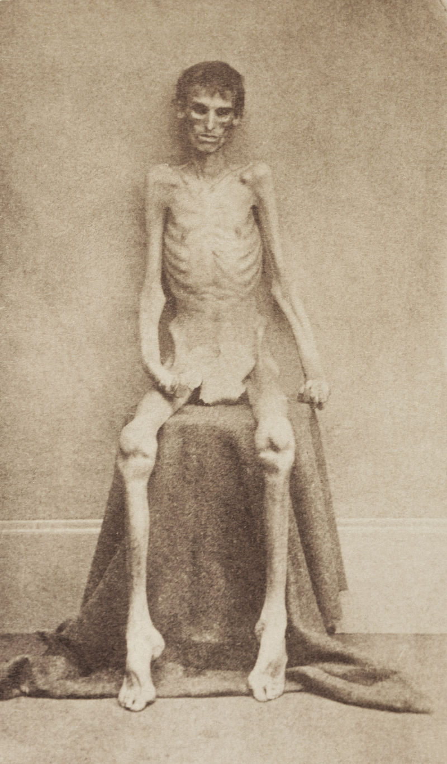
Andersonville, GA
1864-1865
45,000 Union Prisoners w/ 13,000 deaths (29% Mortality rate)
Scurvy, diarrhea, dysentery
1865 Henry Wirz (Conf. Officer) was hung for war crimes
Notes:
Numbers 32:23b . . . behold, you have sinned against the Lord, and be sure your sin will find you out.
https://en.wikipedia.org/wiki/Andersonville_National_Historic_Site#/media/File:Andersonville_Prison.jpg
https://en.wikipedia.org/wiki/Andersonville_National_Historic_Site#/media/File:Andersonvillesurvivor.jpg

Slide 46
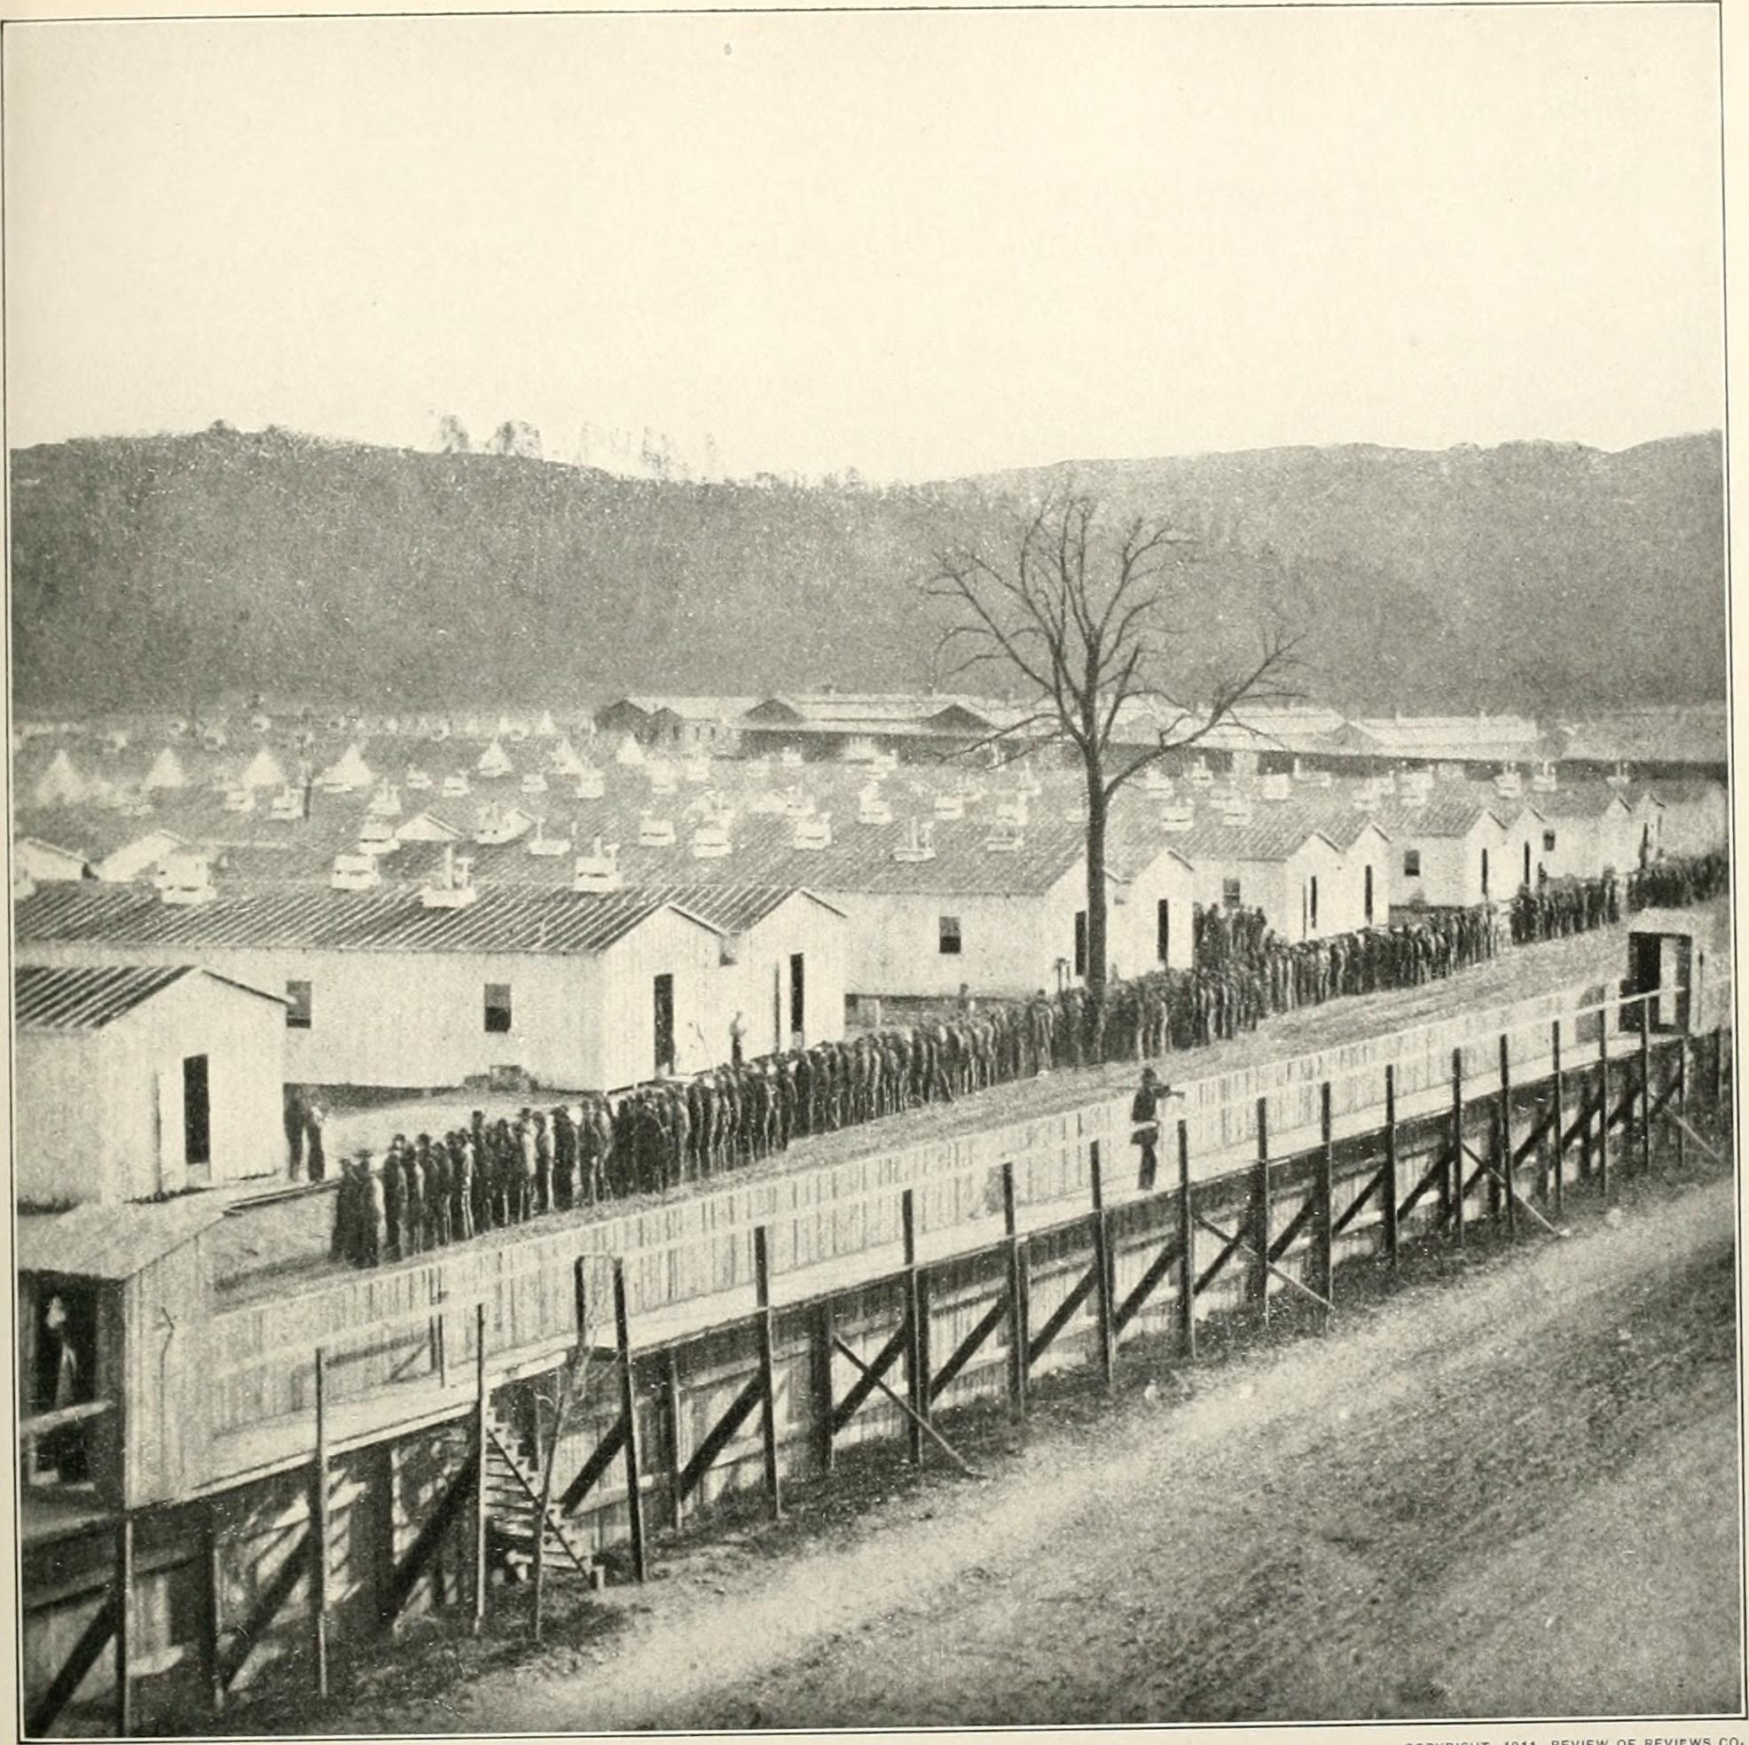
Elmira, NY
Union Forces 12,121 imprisoned, 2,963 deaths (25% mortality rate)
Enough Space for 5,000
Insufficient food, dysentery, typhoid, pneumonia, small pox
Visitors charged 10¢ to see prisoners
Prisoners charged 5¢ for rat meat
Notes:
https://www.stargazette.com/story/news/local/2014/07/26/elmira-civil-war-prison-camp/13191117/
https://en.wikipedia.org/wiki/Elmira_Prison#/media/File:The_photographic_history_of_the_Civil_War_-_thousands_of_scenes_photographed_1861-65,_with_text_by_many_special_authorities_(1911)_(14760407854).jpg

Slide 47
Moral Argument for the Existence of God
Objective evil is real and exists.
If objective evil exists, then objective good exists.
If objective evil and objective good exist, then an objective standard exists.
If an objective standard exists, then an objective standard Giver exists.

Slide 48
Moral Argument for the Existence of God
While the atheist and agnostic use “evil” attempting to justify unbelief, the theist reasons from evil to the existence of God who ultimately and finally deals with evil.

Slide 49
References
Ferguson A. Liberty, Equality, Dignity: Leon Kass Challenges the Scientific Project. Weekly Standard. 2002;8(8). https://www.weeklystandard.com/Content/Public/Articles/000/000/001/819ceqtp.asp.
Ruby L. Logic. Second ed. Chicago: J.B. Lippincott Company; 1960:131.
Ruby L. The Art of Making Sense. Philadelphia: J.B. Lippincott Company; 1954: 20.
Ruby Logic, 131-144.
Ruby Logic, 262-268.
Simmons K. Truth. In: Borchert D, ed. Encyclopedia of Philosophy.Second ed.: McMillan Reference; 2005: 534-535.
Joad CEM. Guide to Philosophy. New York: Dover Publications; 1936: 432-436.
Veatch R, Haddad A, English D. Case Studies in Biomedical Ethics. New York: Oxford University Press; 2010: 8-10.
Solomon RC, Martin C, Vaught W. Morality and The Good Life. New York: McGraw-Hill; 2009.
Kaufman F. Life's Hardest Questions: Big and Small. New York: McGraw-HIll; 2010.
Beauchamp TL, Childress JF. Principles of Biomedical Ethics. 6th ed. New York: Oxford University Press; 2009.
Pellegrino ED. Some Things Ought Never Be Done: Moral Absolutes in Clinical Ethics. Theoretical Medicine and Bioethics. 2005;26:469-486.
Veatch RM. The Basics of Bioethics. Second ed. Upper Saddle River: Prentice Hall; 2003.
Pence GE. The Elements of Bioethics. New York: McGraw-HIll; 2007: 1-11.
Miller D. The Silencing of God. Montgomery: Apologetics Press; 2008, 45.

Slide 50
Christian Ethics

