Slide 1

Ethics at the end of life
The Rise of Physician Assisted Suicide (PAS)

Slide 2
988
Suicide and Crisis lifeline
Call or Text

Slide 3

Deuteronomy 30:19-20a
¹⁹ I call heaven and earth to witness against you today, that I have set before you life and death, blessing and curse. Therefore choose life, that you and your offspring may live, ²⁰ loving the LORD your God, obeying his voice and holding fast to him, for he is your life and length of days

Slide 4
Biblical Ethics of PAS
Human life is sacred
  Man is created in the image of God (Gen. 1:27).
  The taking of innocent human life is condemned (Ex. 20:13)
  God values human life above all other life forms (Matt. 6:26).
No one dies in a vacuum free of responsibility or consequences.
  “For none of us lives for himself and none dies for himself” (Romans 14:7).
Notes:
4

Slide 5
Bible on Death
A time to die (Eccl. 3:2); an appointment (Heb. 9:27).
In life and death, we can glorify God (1 Cor. 6:20).
Our march toward death (wasting) and affliction can prepare us for an eternal weight of glory (2 Cor. 4:16-17).
May we live and die to the Lord (Rom. 14:8).
Christ can be honored in our death (Phil. 1:20).
Death of the righteous – a rest and blessed (Rev. 14:13).

Slide 6
What is Physician Assisted Suicide (PAS)?
Physician Assisted Suicide (PAS) is when a patient voluntarily self-administers a lethal dose of medication that is prescribed (assisted) by a physician that terminates one’s own life (suicide).
Key Distinction: the patient administers the final step that results in death.
Notes:
6

Slide 7
Physician Assisted Suicide (PAS)
Also Called:
Medical Aid in Dying (MAID)
Physician Assisted Death (PAD)
Doctor-aided Dying
Physician Aid-in-Dying
Pharmaceutically Assisted Death
Death with Dignity
Medical Killing
Directed Dying
Assisted Dying
Deliverance
Clinician-Assisted Death
D. Colburn, 2006; M. Schneiderhan,1999.
Notes:
OMEGA, Vol. 40(1) 89-99, 1999-2000
PHYSICIAN-ASSISTED SUICIDE AND EUTHANASIA:
THE PHARMACIST’S PERSPECTIVE
MARK E. SCHNEIDERHAN, PHARM.D., BCPP
University of Illinois at Chicago
College of Pharmacy
Colburn, D. (November 15, 2006). “Oregon Officials Seek Neutral Term for 'Assisted Suicide.’” Newshouse News Service.
7

Slide 8
What is voluntary Active Euthanasia (VAE) / “Euthanasia”?
Voluntary Active Euthanasia (VAE) is when the patient voluntarily requests the physician commits an act that results in death (e.g. IV injection). The physician intends death.
  In Canada (legalized 2016), both PAS and Euthanasia (direct administration by an ARNP or physician) are legal
  13,000 Canadians have died from medically assisted death
https://www.dyingwithdignity.ca/get_the_facts_assisted_dying_law_in_Canada, https://www.bbc.com/news/world-us-canada-51620021

Slide 9
Strict Definitions of Euthanasia: Key Distinctions
Active* Euthanasia - taking human life (killing)
  *Some say that the term “active” may be potentially misleading because removing a ventilator as an action is “active,” but classified as passive euthanasia.
Passive Euthanasia - allowing to die
Voluntary Euthanasia
  Individual is competent, given informed consent
Mappes, T. A., & Degrazia, D. (Eds.). (2006). Biomedical Ethics (Sixth ed.). Boston: McGraw Hill, pg. 380.
Notes:
Some clarifications taken from Stephen Poff’s slides
9

Slide 10
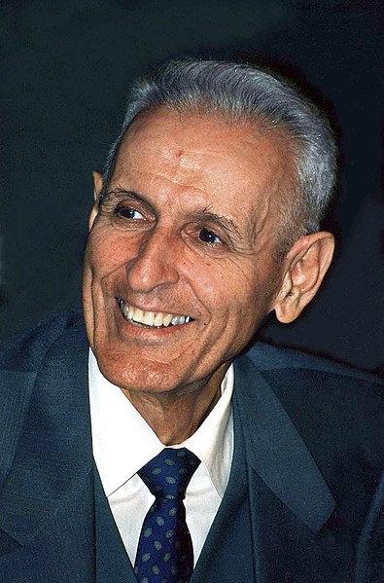
Jack Kevorkian
Pathologist and Euthanasia proponent (1928-2011)
Assisted in the deaths of 130 terminally ill patients, beginning in 1990
Spent 8 years in prison
Famous Death Machine “Thanatron”
https://www.nytimes.com/2011/06/04/us/04kevorkian.html
Kingkongphoto & www.celebrity-photos.com, Wash. D.C. Press Club, 1996, https://www.flickr.com/photos/kingkongphoto/5113180266/
Notes:
http://www.youtube.com/watch?v=Rk3ri1ADIsI

Slide 11
How “thanatron” Worked
Saline Solution
Sodium Thiopental
  Puts one in a deep coma
Concentrated Potassium Chloride
  Starts 60 Seconds Later
  Paralyzes the heart and causes death
Death in about 4 Minutes
https://www.youtube.com/watch?v=Rk3ri1ADIsI

Slide 12
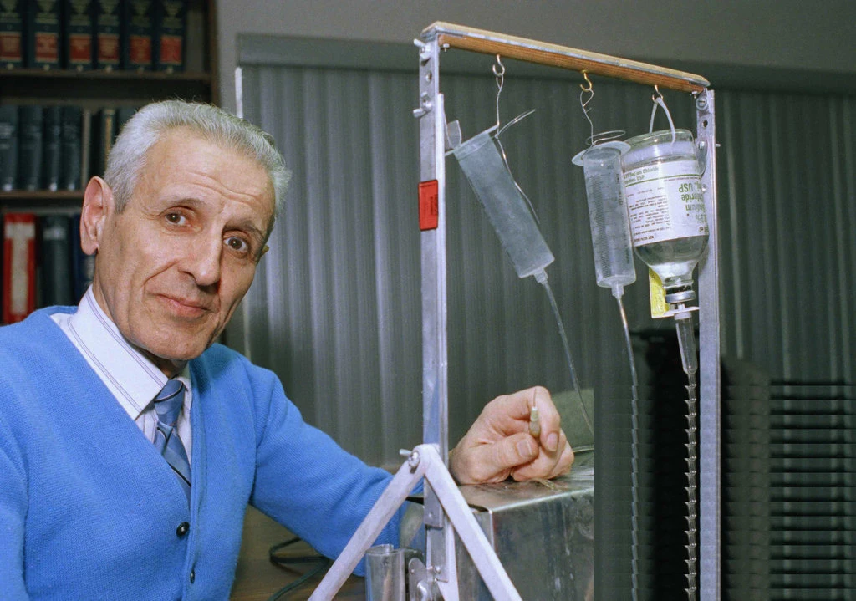
Physician Assisted Suicide
“Suicide Machine”
“Thanatron” Machine
“Mercitron” Machine
Image Source: https://static01.nyt.com/images/2011/06/04/us/jpKEVORKIAN1-obit/jpKEVORKIAN1-obit-jumbo.jpg?quality=90&auto=webp
Notes:
https://www.nytimes.com/2011/06/04/us/04kevorkian.html
12

Slide 13
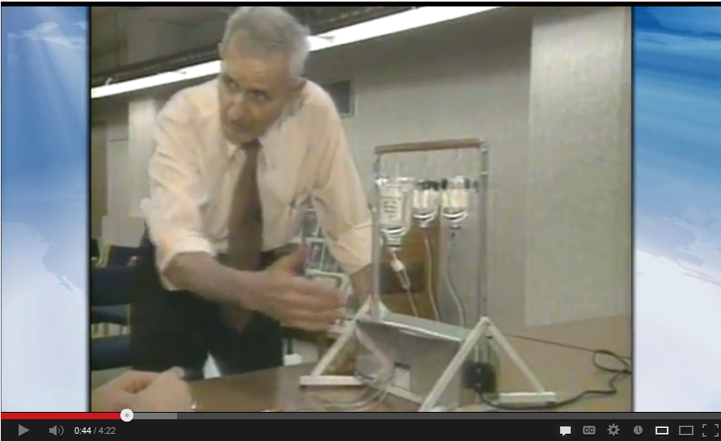
Dr. Kevorkian
http://www.youtube.com/watch?v=OJsbefxfVsg

Slide 14

Switzerland Approves Suicide Capsule “SARCO Suicide Pod” Dec. 6, 2021
Developed by Exit International/ Dr. Philip Nitschke – “Dr. Death”
The pod floods with Nitrogen & Oxygen goes from 21 to 1%
Die in about ½ a minute
Coffin Like Capsule
In 2020 about 1,300 died from assisted suicide in Switzerland
https://thehill.com/changing-america/well-being/584513-assisted-suicide-pod-approved-in-switzerland?utm_source=join1440&utm_medium=email&utm_placement=newsletter
Notes:
https://thehill.com/changing-america/well-being/584513-assisted-suicide-pod-approved-in-switzerland?utm_source=join1440&utm_medium=email&utm_placement=newsletter
https://www.exitinternational.net/sarco/concept/
https://www.swfinstitute.org/news/89938/switzerland-approves-suicide-pods

Slide 15
Legal Issues

Slide 16
Euthanasia
Not Legal in the United States
Legal in Belgium, Canada, Luxemburg, Netherlands, New Zealand, Spain
Australian states default to PAS, but patients petition government for IV administration
Switzerland permits IV administration, but requires the patient open the valve
Battin, Maragaret, Thaddeus Pope, Lonny Shavelson. “Medical Aid in Dying: Ethical and Legal Issue.” Uptodate, July 2023.

Slide 17
U.S. Supreme Court
Is there a constitutional right to suicide or death with dignity?
Washington v. Gluksberg (1997)
  Does Washington’s prohibition against “causing” or “aiding” a suicide offend the Fourteenth Amendment? Court says NO!
The decision to commit suicide with the assistance of another has never enjoyed legal protection.
  Under the constitution we have no liberty to suicide.
https://supreme.justia.com/cases/federal/us/521/702/
Notes:
What are the 5 main points of the 14th Amendment?
The Fourteenth Amendment contains a number of important concepts, most famously state action, privileges & immunities, citizenship, due process, and equal protection—all of which are contained in Section One.
https://www.law.cornell.edu/wex/fourteenth_amendment_0#:~:text=The%20Fourteenth%20Amendment%20contains%20a,are%20contained%20in%20Section%20One.

Slide 18
U.S. Supreme Court
Is there a constitutional right to suicide or death with dignity?
Vacco v. Quill (1997) [Equal Protection]
  Does NY State’s ban on preventing someone assisting in suicide violate the equal protection clause of the 14th Amendment?
    Ct. says No.
  “Neither New York’s ban on assisting suicide nor its statutes permitting patients to refuse medical treatment treat anyone differently than anyone else or draw any distinctions between persons.”
https://supreme.justia.com/cases/federal/us/521/793/

Slide 19
U.S. Supreme Court
What the Rulings Mean
  There is no federal constitutional right to physician assisted suicide
  States are left to decide

Slide 20
PAS and United States
Federal Law
  No Right to Die
  Supreme Ct. has addressed in Washington v. Gluksberg (1997), Vacco v. Quill (1997)
Legal in 10 States
  9 by legislation (CA, CO, HI, ME, NJ, NM, OR, VT, and WA)
  1 State by court ruling (MT)
  + District of Columbia
40 States Prohibited
https://euthanasia.procon.org/states-with-legal-physician-assisted-suicide/

Slide 21
States that Allow the Practice
Oregon – 1994 Death with Dignity Act signed
Washington State – 2008 Death with Dignity Act
Montana – 2008 District’s Judges Decision allows in Baxter v. Montana
Vermont – 2013 Patient Choice and Control at the End-of-Life Act
California – 2015 End of Life Option Act
Notes:
http://www.huffingtonpost.com/the-conversation-us/californians-now-have-rig_b_10415552.html, http://euthanasia.procon.org/view.timeline.php?timelineID=000022#2000-present , http://www.procon.org/headline.php?headlineID=005343
https://euthanasia.procon.org/view.resource.php?resourceID=000132
https://www.deathwithdignity.org/learn/death-with-dignity-acts/

Slide 22
States that Allow the Practice
Colorado – 2016 End of Life Options Act
Washington DC – 2017 Death with Dignity Act
Hawaii – “Our Care, Our Choice Act” effective Jan. 1, 2019
Maine – 2019 Death with Dignity Act
New Jersey – 2019 Aid in Dying for Terminally Ill Act
New Mexico – 2020 Elizabeth Whitefield End of Life Options Act
Notes:
http://www.huffingtonpost.com/the-conversation-us/californians-now-have-rig_b_10415552.html, http://euthanasia.procon.org/view.timeline.php?timelineID=000022#2000-present , http://www.procon.org/headline.php?headlineID=005343
https://euthanasia.procon.org/view.resource.php?resourceID=000132
https://www.deathwithdignity.org/learn/death-with-dignity-acts/

Slide 23
Oregon Legislates the Language of Physician Assisted Suicide
THE OREGON DEATH WITH DIGNITY ACT OREGON REVISED STATUTES
  127.880 §3.14. Construction of Act. Nothing in ORS 127.800 to 127.897 shall be construed to authorize a physician or any other person to end a patient’s life by lethal injection, mercy killing or active euthanasia. Actions taken in accordance with ORS 127.800 to 127.897 shall not, for any purpose, constitute suicide, assisted suicide, mercy killing or homicide, under the law. [1995 c.3 §3.14]
Note, the state legislates what it may not be called.
Notes:
http://public.health.oregon.gov/ProviderPartnerResources/EvaluationResearch/DeathwithDignityAct/Documents/statute.pdf

Slide 24
Washington, Initiative 1000
RCW 70.245.180 Authority of chapter — References to practices under this chapter — Applicable standard of care.
  (1) Nothing in this chapter authorizes a physician or any other person to end a patient's life by lethal injection, mercy killing, or active euthanasia. Actions taken in accordance with this chapter do not, for any purpose, constitute suicide, assisted suicide, mercy killing, or homicide, under the law. State reports shall not refer to practice under this chapter as "suicide" or "assisted suicide." Consistent with RCW

Slide 25
What’s the big deal?
Does it matter when language is legislated?
Note that the language is value laden. Some reason:
  “Death” doesn’t sound as bad as “suicide”
  “Medical Aid in Dying” and “Death with dignity” sound better than “Physician Assisted Suicide”
What other place of historical significance legislated what physician assisted suicide may be called? NAZI GERMANY!!

Slide 26
The Candidate and event

Slide 27
candidate
18 Years
Terminal condition with less than 6 months to live
  Determined by 2 Independent Physicians
Must have ability to administer without assistance
Have decision making capacity - No coercion
Receive Hospice Care

Slide 28
Drug Dosing in PAS
Lethal Dose | Therapeutic Doses | Orders of Magnitude
Diazepam 1,000 mg | 5-10 mg | 100-200 X
Digoxin 100 mg | 0.125-0.250 mg | 400-800 X
Morphine 15,000 mg | 5-30 mg | 500-3,000 X
Amitriptyline 8,000 mg | 10-150 mg | 53-800 X
Phenobarbital 5,000 mg | 15-100 mg | 50-333 X
American Clinicians Academy on Medical Aid in Dying, https://www.acamaid.org/pharmacologyinfoupdates/

Slide 29
Important – Don’t Blur the Lines
Comfort care at the end of life is not the same as killing
“The ending of suffering by ending life has been held as distinct from palliative care, which relieves suffering without intentionally hastening death.”– American Academy of Hospice and Palliative Care Physicians, https://aahpm.org/positions/pad

Slide 30
Important – Don’t Blur the Lines
Doses of drugs can be carefully controlled for side effects
Withholding or withdrawing treatment that leads to death is not the same as killing
  One let’s nature take its course
  The other intends and hastens death
Palliative/ Terminal Sedation is not PAS

Slide 31
Biblical ethics

Slide 32
Biblical View of Life
Life is sanctified – “calls for reverence” (Gen. 1:27, Ps. 139:13-19)
Neighbors are to be loved, not killed (Matt. 22:37-39)
Life is dignified – “calls for respect” (Ps. 8:4, Rom. 5:8)
We must do good to all, exercising compassion (Gal. 6:10, Col. 3:12-15)
God has power over life, and we should choose life (Deut. 30:19-20, 32:39)
Geisler, N. L. (1990). Christian Ethics Grand Rapids: Baker Book House, p. 187.

Slide 33
Biblical View of Killing and Death
Shedding innocent blood is forbidden (Gen. 9:5, Prov. 6:16-17, Deut. 19:10-11)
Murder is forbidden (Matt. 15:19, Rom. 1:29, 13:9, Rev. 21:8)
Christ delivers us from the fear of death (Heb. 2:15)
Last enemy is death (1 Cor. 15:26,56)
Christ conquers (Rom. 6:9) abolishes (2 Tim. 1:10) and destroys death (1 Cor. 15:26)
Christ is victorious over death (1 Cor. 15:55, 57)

Slide 34
The Bible on the End of life
Extend Sincere Compassion
  Mark 1:41 Moved with pity, he stretched out his hand and touched him [leper] . . .
  Matthew 9:36 When he saw the crowds, he had compassion for them, because they were harassed and helpless, . . .
  James 5:11 . . . the Lord is compassionate and merciful.
Notes:
34

Slide 35
Bible on the end of life
Alleviate Pain and Comfort the Afflicted
  “Give strong drink to the one who is perishing, . . .” (Prov. 31:6).
See Value in Suffering
  In altruistic self-sacrifice (Hebrews 2:9-10)
  In character development (Rom. 5:3-5, Heb. 12:11)
  In overcoming the last enemy of death (1 Cor. 15:20-34)
Notes:
35

Slide 36
Does Loss of Autonomy
Justify Pas?
Human autonomy is not without limits (Col. 3:17)
  We cannot love ourselves/ neighbors while killing them (John 13:35, Matt. 22:37-40)
  We cannot use our autonomy for self-destruction or taking innocent human life (1 Cor. 13:4-8)

Slide 37
What about my autonomy?
PAS cannot include autonomy
  It ends autonomy
  Causes harms to others – grief, anguish
  Offends God
Battin, Maragaret, Thaddeus Pope, Lonny Shavelson. “Medical Aid in Dying: Ethical and Legal Issue.” Uptodate, July 2023.

Slide 38
Is Mercy killing justified?
“Act of Mercy” Misleading
Presenting PAS as an act of mercy or avoiding suffering is misleading
  Killing an innocent person does not alleviate suffering; it causes suffering.
  Killing an innocent person is not an act of mercy; it is unmerciful act.
Norman Geisler, Christian Ethics, 1990.
Notes:
38

Slide 39
Does Loss of dignity Justify PAS?
Who or what is informing the concept of dignity?
1 Timothy 2:1-4 First of all, then, I urge that supplications, prayers, intercessions, and thanksgivings be made for all people, ² for kings and all who are in high positions, that we may lead a peaceful and quiet life, godly and dignified in every way. ³ This is good, and it is pleasing in the sight of God our Savior, ⁴ who desires all people to be saved and to come to the knowledge of the truth.

