Slide 1
Biblical Evaluation of the “Four Principles of Biomedical Ethics”
Daniel Stearsman

Slide 2
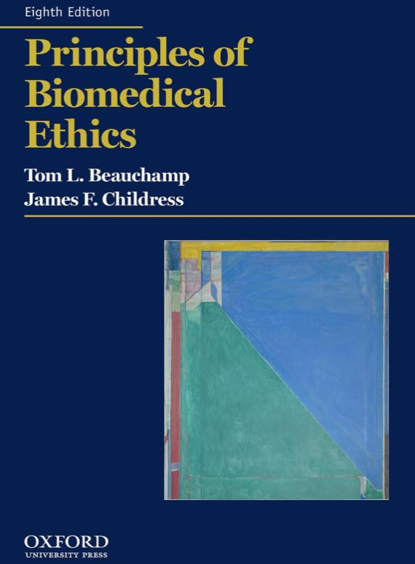
Principles of Biomedical Ethics
1977– 1st Edition
2019 – 8th Edition
https://www.amazon.com/Principles-Biomedical-Ethics-Tom-Beauchamp/dp/0190640871/ref=pd_sbs_14_1/136-8480132-2115344?_encoding=UTF8&pd_rd_i=0190640871&pd_rd_r=507b205d-d919-4a45-87cb-4bc004282c85&pd_rd_w=0AFxw&pd_rd_wg=n218K&pf_rd_p=7cd8f929-4345-4bf2-a554-7d7588b3dd5f&pf_rd_r=N1ZVSYPKHSJG2CKNG5K2&psc=1&refRID=N1ZVSYPKHSJG2CKNG5K2

Slide 3
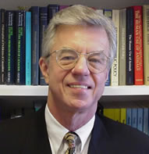
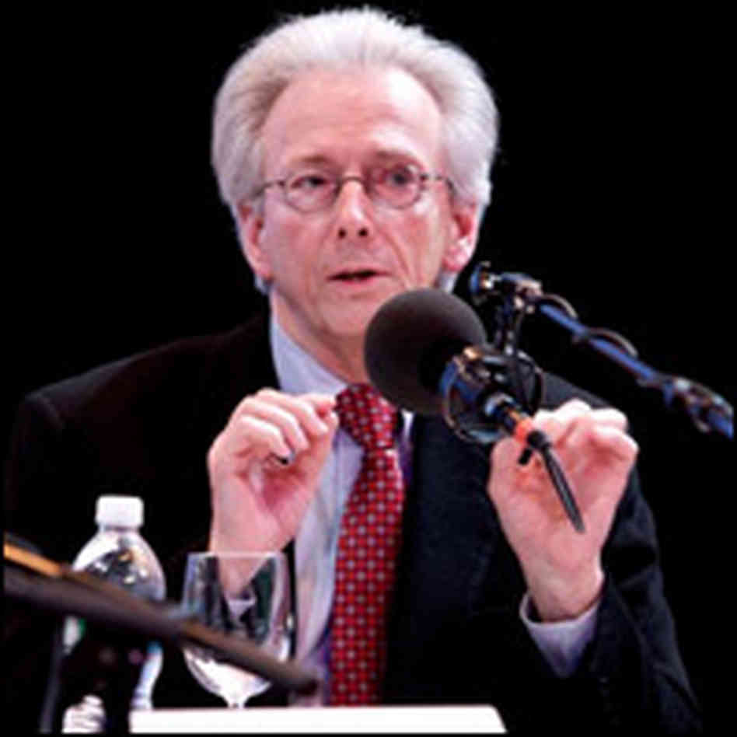
Tom Beauchamp
James Childress
Ph. D. Professor of Philosophy and Senior Research Scholar Georgetown Kennedy Institute of Ethics
Ph.D. Department of Religious Studies, University of Virginia
http://media.npr.org/news/specials/iq2/organs/childress200-73ad3ac929281dd7caceff09d80c19595cfcfb71-s6-c10.jpg
http://www.yale.edu/bioethics/Levine2009.htm

Slide 4
Case of Mrs. I. L. Knifee
A 69 year old woman was admitted to the emergency department with two self-inflicted knife wounds to the neck. She has low blood pressure. But, at the time, is not actively bleeding. She was intubated, given IV fluids and was about to be sent to the operating room when her family arrived.
Adapted from Paul Appelbaum, Biomedical Ethics: a Multidisciplinary approach to moral issues in medicine and biology, David Steinberg, ed. (Lebanon: University Press of New England, 2007) 215.

Slide 5
Case (cont.)
Her husband, the appropriate surrogate decision maker arrives, demands she be extubated and all treatment stops. He said his wife suffered for decades with depression, often wanted to die and had not responded to therapy, antidepressants, or electroshock therapy. The patient’s psychiatrist is consulted and says she is the worst case of depression he had seen in 20 years of practice.
You are called to the hospital. What do you tell the family to do?
Adapted from Paul Appelbaum, Biomedical Ethics: a Multidisciplinary approach to moral issues in medicine and biology, David Steinberg, ed. (Lebanon: University Press of New England, 2007) 215.

Slide 6
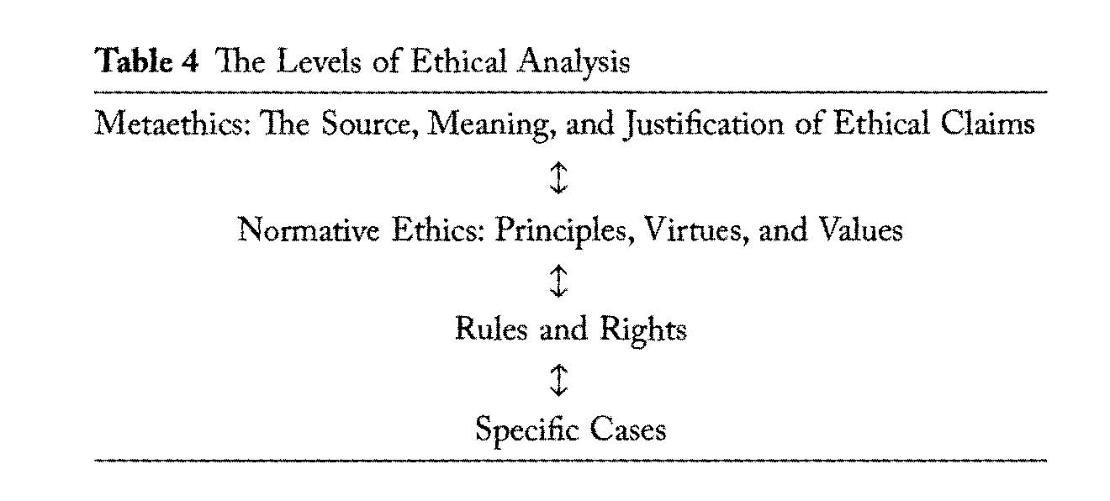
Veatch R, Haddad A, English D. Case Studies in Biomedical Ethics. New York: Oxford University Press; 2010, 18.

Slide 7
Various Principle Based Approaches

Slide 8
What is a principle?
A moral standard (a moral norm) for evaluating or judging whether a claim is right or wrong
Take the Principle of Truth Telling – Principle of Veracity
  If truth telling is valued, lying is judged to be wrong based upon the principle of veracity

Slide 9
Biblical Principles
Ten Commandments (Ex. 20)
Beatitudes (Matt. 5:2-12)
Fruit of the Spirit (Gal. 5:22-24)
Works of the Flesh (Gal. 5:19-21)
Descriptions of Love (1 Cor. 13)
Christian Armor (Eph. 6:11-24)
The Christian Graces (2 Peter 1:5-8)

Slide 10
A Three-Principle Approach
The Belmont Report (1976)
  Respect for Persons
  Beneficence
  Justice
Notes:
http://ohsr.od.nih.gov/guidelines/belmont.html, last accessed September 7, 2009.

Slide 11
Four Principles
Also Known As:
Four Principles
The Four Principles Approach
Principlist Approach
Principlism
Georgetown Mantra
Georgetown Approach
Autonomy
Beneficence
Nonmaleficence
Justice

Slide 12
Four-Principle Approach
Top-Down Approach
  Starts with the principles or maxims and applies to cases
  Bottom up, starts with the cases and searches for principles
    This is called clinical Casuistry
Side Note
  In evangelism to what extent is Top-Down versus Bottom-Up helpful in planting and watering?
    Top-down would start with hearing, believing, repenting, confessing, and being baptized and seek conformity
    Bottom-up would start with the gospel accounts and let the response come as an outworking of knowing the authentic Christ

Slide 13
B/C: Standards of Action (Rules of Obligation) in the Common Morality
Do not kill
Do not cause pain or suffering to others
Prevent evil or harm from occurring
Rescue persons in danger
Tell the truth
Nurture the young and dependent
Keep your promises
Do not steal
Do not punish the innocent
Obey the law
Notes:
Beauchamp TL, Childress JF. Principles of Biomedical Ethics. 6th ed. New York: Oxford University Press; 2009. The common morality is described by Beauchamp and Childress. It is not merely a morality, but the universal morality that is “the set of norms shared by all persons committed to morality” (p. 3). It is described as “applicable to all persons in all places, and we rightly judge all human conduct by its standards” (p 3).

Slide 14
B/C: Moral Character Traits/ Virtues (Vices) recognized in the Common Morality
Nonmalevolence (Malevolence)
Honesty (Dishonesty)
Integrity (Lack of Integrity)
Conscientiousness
Trustworthiness
Fidelity
Gratitude
Truthfulness
Lovingness
Kindness
Notes:
Malevolence has to do with having a bad will. http://www.merriam-webster.com/dictionary/malevolent, last accessed Sept. 10, 2009.
A person acts conscientiously if “he or she is motivated to do what is right because it is right, has tried with due diligence to determine what is right, intends to do what is right, and exerts an appropriate level of effort to do so.” (Beauchamp and Childress, p. 43).
The authors comment that like the prior list, these are not exhaustive lists. Beauchamp and Childress call “the development and expression of caring” the “fundamental orienting virtue” and from this comes the five focal virtues of: compassion, discernment, trustworthiness, integrity and consciousness (p. 38).

Slide 15
Baruch Brody: A Five-Appeals Approach
Respect for Persons
Consequences of our Actions (taken as Utility or the combined consideration of beneficence and nonmaleficence)
Rights (as in right making, duty or principle)
Appeal to cost-effectiveness and justice
An appeal to the virtues
Notes:
Baruch A. Brody, Ph.D. is the Leon Jaworski professor of Biomedical Ethics and director of the Center for Medical Ethics and Health Policy at Baylor College of Medicine. He is also the Andrew Mellow professor of Humanities in the Department of Philosophy at Rice University. In 2002, he was appointed Distinguished Service professor at Baylor, the college's highest faculty honor, and was also awarded the Michael E. DeBakey Award for outstanding research.” http://www.bcm.edu/ethics/?pmid=3833, last accessed September 7, 2009.

Slide 16
W.D. Ross: Six Prima Facie Duties
Beneficence
Nonmaleficence (“not injuring others”)
Self-Improvement
Justice
Promise Keeping (duty Not to Tell Lies)
Reparation (cf. Luke 19:8)
Notes:
W.D. Ross (1877-1971) was a British Aristotelian Scholar who was a great contributor to Aristotelian Ethics. His works include: Aristotle (1923), The Right and the Good (1930), the Foundations of Ethics (1939), and Plato’s theory of Ideas (1951). Stout AK. William David Ross. In: Borchert DM, ed. Enclopedia of Philosophy. Vol 8. 2nd ed. Detroit: Macmillan Reference USA; 2006:504-506.
Sometimes these are listed as Seven Duties: fidelity, reparations, gratitude, justice, beneficence, self-improvement, and nonmaleficence. See http://www.hu.mtu.edu/~tlockha/hu329ov8.htm, last accessed September 6, 2009.

Slide 17
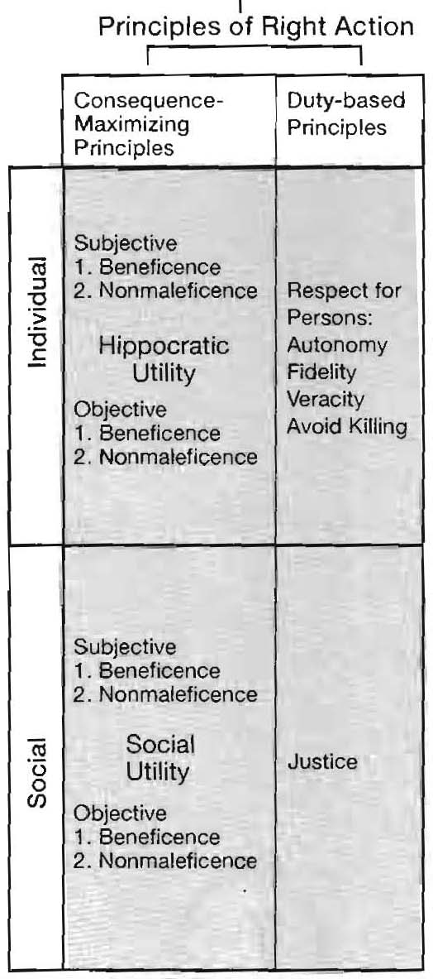
Robert M. Veatch’s Seven-Principle Approaches
Beneficence
Nonmaleficence
Autonomy
Fidelity
Veracity
Avoid Killing
Justice
Notes:
To Veatch Utility is the assessment of benefit and harm. Beneficence is doing good, that is, producing good consequences; Nonmaleficence is avoiding doing harm (avoid producing bad consequences). Individual Subjective Hippocratic Utility is when the physician operating on his/ her own judgme*nt decides what should be done to benefit the patient. Here benefits and harms are assessed/determined by the physician. Individual Objective Hippocratic Utility is when judgments of outcomes are based on peer review, utilization review, quality assurance, outcomes research, treatment protocols or collegial consensus. InVeatch argues that Individual Subjective Hippocratic Utility is when a Physician bases a decision on patient benefit based on his/her own judgment. Social Utility is the goal of classical utilitarianism, that is, an action or rule is morally right insofar as it produces more net good consequences as any alternative, taking into account benefits (beneficence) and harms (nonmaleficence) for all parties. “Here the goal is the greatest aggregate good” (Veatch, 123).
Veatch RM. The Basics of Bioethics. Second ed. Upper Saddle River: Prentice Hall; 2003.

Slide 18
Bernard Gert/ Charles Culver/ K. Danner Clouser: A Ten Moral Rule Approach
Do not harm (overarching principle)
Do not deprive of freedom (autonomy)
Do not deceive (veracity)
Do not kill (avoidance of killing)
Do not cheat (fidelity)
Obey the law (fidelity)
Do your Duty (Associated with your role)
Do not Cause Pain
Do not Disable
Do not Deprive of Pleasure

Slide 19
Principles are one More Reason to Reject Ethical Relativism
Why?
  In any functioning society, definitions of principles cannot just be continuously debated. Conflict must be resolved for societies and social groups to flourish.
  Law cannot force someone to love truth and hate lying, but law can define and set forth definitions of lying and define punishments for it
    Forgery – falsifying in writing
    Perjury – lying under oath

Slide 20
Basis of the Four Principles
Common Morality Versus Particular Morality
Common Morality
  Universal
  Not “a” morality, but “the” morality
Critique of Their View
  Yes – universal “the”, not “a” morality = pluralism
  Not a product of human history and experience (man created), but God given

Slide 21
Basis of the Four Principles
Common Morality Versus Particular Morality
Particular (Local) Morality
  Morality in a specific, particular context or location
  Examples = country, state, city, job site, home, church
  Biblically
    Elder-Flock (1 Tim. 5:17, Heb. 13:17)
    Husband-Wife (Eph. 5:22ff, Col. 3:18-19)
    Parent-Child (Eph. 6:1, Col. 3:20)
    Culture-Residents
      Rebekah with a veil was a sign of propriety, modesty, moral decency (Gen. 24:65)
      Tamar’s veil - a sign of prostitution (Gen. 38:14,19)

Slide 22
Particular (Local) Morality and Culture
“When in Rome….”
  1 Corinthians 9:21–23 To those outside the law I became as one outside the law (not being outside the law of God but under the law of Christ) that I might win those outside the law. 22 To the weak I became weak, that I might win the weak. I have become all things to all people, that by all means I might save some. 23 I do it all for the sake of the gospel, that I may share with them in its blessings.
    What does this text mean morally (cf. Acts 5:29)?
  Culture is Subject to the law of Christ
Rebekah v. Tamar
  Rebekah’s veil – culturally, was propriety moral decency (Gen. 24:65)
  Tamar’s veil - culturally, a sign of prostitution (Gen. 38:14,19)
  What does a veil signify today in America?

Slide 23
Stopped

Slide 24
Particular (Local) Morality and Seasonal Customs
Why might I put up a Christmas tree in America, while not putting up a tree if I lived in Ghana, West Africa?
  In America, the season/day can have social, civil, or familial significance and no religious significance
    This seems odd, if not impossible, for a Ghanaian who has never been to America
  In Ghana, a tree carries much stronger perception of being Catholic, celebrating Christmas day, or perception of celebrating the season of Advent.

Slide 25
Particular (Local) Morality and Seasonal Customs
Why might I put up a Christmas tree in America, while not putting up a tree if I lived in Ghana, West Africa?
Remember
  In America, one might object to a Christmas tree on no religious grounds at all.
    An atheist might object on the grounds of materialism, consumerism, or commercialism.
    An atheist might object on the grounds of history (e.g. Roman Saturnalia, German Pagan Oden worship)

Slide 26
Particular (Local) Morality and Seasonal Customs
Why might I put up a Christmas tree in America, while not putting up a tree if I lived in Ghana, West Africa?
  For the Christian
    Everyday and every season one can celebrate the incarnation – heaven’s richest gift to earth
      Isaiah 9:2 The people who walked in darkness have seen a great light; those who dwelt in a land of deep darkness, on them has light shone.
      Hebrews 1:6 And again, when he brings the firstborn into the world, he says, “Let all God’s angels worship him.”
      This happened in the fullness of time (Gal. 4:4)
      And it is good news (Luke 2:10-11).
  But, me putting up a tree has nothing to do with Christ’s incarnation or coming.
    I light lights and color and glimmer shiny ornaments.

Slide 27
Particular / Local Morality and Familial Decisions
Must a parents homeschool their children to be moral and glorify God?
  Some Homeschooling Parents – May believe if one doesn’t homeschool their kids will be handed over to Satan.
    Is this true?
    Are there spiritually faithful parents who homeschool and are in the world but not of the world (John 17)?
  Some Public School Parents – May neglect to take the spiritual investment time to carefully detect where godless education leads
    Are public school parents actively engaged in the spiritual and moral warfare that comes from evolution, sexism, objectification of women, porn, LGBTQ, postmodernism, and substance abuse (Eph. 6)?

Slide 28
Principles
Negative Principle – Nonmaleficence
  Do no harm
Positive Principles
  Autonomy – Self Determination, Self-Direction
    Agency and Liberty
  Beneficence – acting for the benefit of others
  Justice – “likes should be treated alike” and “equals ought to be treated equally and unequals unequally” (B/C 6).

Slide 29
Example – Frame the following conflict with the 4 principles
Roxane has 3 kids. Recently, she had a one-night stand hoping to get back at her husband who cheated on her for 2 years with multiple women. Currently, she has passed her menstrual cycle by 3 weeks. She knows its not her husbands. She calls you to tell you she’s off to the “women’s clinic” to have an abortion.
Frame the moral conflict using the 4 principles.

Slide 30
Who are the parties?
  Roxanne – Abort, Avoid Consequences, Get back at her cheated husband….
  Husband
  Baby Daddy
  Child
Moral Questions/ Issues
  Is it morally acceptable for Roxanne to cheat on her husband given that he’s cheated on her?
    Her Beneficence (good) trumps beneficence (of the child) Nonmaleficience and justice
  His revenge?
  Killing child?

Slide 31
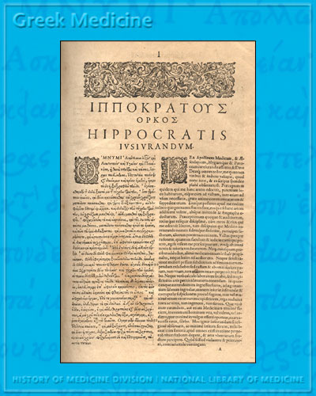

Hippocratic Oath - 5th Century BC
Of what value is the Hippocratic oath to the Christian?
  Does not contain, “First, do no harm”
  Does say
    “I will use those dietary regimens which will benefit my patients according to my greatest ability and judgement, and I will do no harm or injustice to them.”
    “I will not give a lethal drug to anyone if I am asked, nor will I advise such a plan; and similarly I will not give a woman a pessary to cause an abortion.”
“I swear by Apollo the physician, and Asclepius, and Hygieia and Panacea and all the gods and goddesses as my witnesses, that, according to my ability and judgement, I will keep this Oath and this contract”
https://www.nlm.nih.gov/hmd/greek/greek_oath.html

Slide 32
Case of Mrs. I. L. Knifee
A 69-year-old woman was admitted to the emergency department with two self-inflicted knife wounds to the neck. She has low blood pressure. But, at the time, is not actively bleeding. She was intubated, given IV fluids and was about to be sent to the operating room when her family arrived.
Adapted from Paul Appelbaum, Biomedical Ethics: a Multidisciplinary approach to moral issues in medicine and biology, David Steinberg, ed. (Lebanon: University Press of New England, 2007) 215.

Slide 33
Case (cont.)
“Her husband, the appropriate surrogate decision maker arrives, demands she be extubated and all treatment stops. He said his wife suffered for decades with depression, often wanted to die and had not responded to antidepressants or electroshock therapy. The patient’s psychiatrist is consulted and says she is the worst case of depression he had seen in 20 years of practice.”
You are called to the hospital. What do you tell the family to do?
Adapted from Paul Appelbaum, Biomedical Ethics: a Multidisciplinary approach to moral issues in medicine and biology, David Steinberg, ed. (Lebanon: University Press of New England, 2007) 215.

Slide 34
Analysis of the Case of Mrs. I. L. Knifee
Mrs. Knifee
Physician’s
Nonmaleficence or beneficence – is her refusal of care an act of self harm (violates the principle of nonmaleficence)? Or is this a beneficent act?
Autonomy – is her act autonomous? Does she have decisional capacity? Has she been declared legally incompetent?
Justice – is it fair, equitable, reasonable?
Nonmaleficence – What are the moral duties not to harm? Is treating her against her wishes harm?
Beneficence – What are there moral obligations for the good?
Autonomy – how do they exercise their autonomy? Does their autonomy take precedent over hers? Do they conscientiously object or conscientiously treat?
Justice – should all similar cases be treated this way?

Slide 35
Analysis of the Case of Mrs. I. L. Knifee
Surrogate
  Nonmaleficence – does respecting her wishes violate the principle of nonmaleficence?
  Beneficence – whose view of beneficence trumps?
  Autonomy – not his first, then hers; rather hers first (substituted judgment), then his (best interest)
  Justice – was she treated fairly

Slide 36

Biblical Analysis of the Four Principles
Nonmaleficence – Biblically, doing no harm recognizes that spiritual harms are not minimized/marginalized
  Galatians 5:19-21 Now the works of the flesh are evident: sexual immorality, impurity, sensuality, ²⁰ idolatry, sorcery, enmity, strife, jealousy, fits of anger, rivalries, dissensions, divisions, ²¹ envy, drunkenness, orgies, and things like these. I warn you, as I warned you before, that those who do such things will not inherit the kingdom of God. . . . Galatians 5:24-25 ²⁴ And those who belong to Christ Jesus have crucified the flesh with its passions and desires. ²⁵ If we live by the Spirit, let us also walk by the Spirit.

Slide 37
Beneficence
Galatians 5:22-23 But the fruit of the Spirit is love, joy, peace, patience, kindness, goodness, faithfulness, ²³ gentleness, self-control; against such things there is no law.
Positive and Prescriptive

Slide 38
Compare Beneficence & Nonmaleficence
  Romans 13:8-10 Owe no one anything, except to love each other, for the one who loves another has fulfilled the law. ⁹ The commandments, "You shall not commit adultery, You shall not murder, You shall not steal, You shall not covet," and any other commandment, are summed up in this word: "You shall love your neighbor as yourself." ¹⁰ Love does no wrong to a neighbor; therefore love is the fulfilling of the law.
  Nonmaleficence (do no harm) – shall nots; proscriptive
  Beneficence – you shall; prescriptive

Slide 39
Autonomy
Autonomy is not necessarily anti-authoritarian (Josh. 24:15, 1 Kings 18:21)
God desires a radical transformation in the exercise of our autonomy
  Choose light and life over sin and darkness (Rom. 8:1-11, John 8:12)
  Crucify the old self (Rom. 6:6)
  Transform the mind (Rom. 12:1-2)
  Deny Self/Take up the cross (Matt. 16:24)

Slide 40
Autonomy (Cont.)
Ability to express autonomy does not remove dignity or sanctity (cf. Ex. 4:11, Ps. 8:4, Gn. 1:26-28, Acts 17:29)
  Sanctity call for reverence, dignity for respect (Geisler 187)
A proper use of autonomy does not demand that we never withhold or withdraw treatment (cf. Phil. 1:21, Rev. 14:13)

Slide 41
Justice
What is an ideal/ perfect system of justice?
“God will provide for himself the lamb for a burnt offering” (Gen. 22:8)

Slide 42
The Bible And Mrs. Knifee
Nonmaleficence
  Self mutilation is forbidden (cf. 1 Kings 18:28)
Beneficence
  Always encourage her that life has value, dignity and is worth living (Gen.1:26-27, John 3:16, 10:10)
Autonomy
  Exercise her autonomy to care for her “temple” (1 Cor. 6:19-20)
Justice
  Beg her not to meet God on the terms of Jesus the Justifier and not to take her own life into her hands and check out prematurely (Rom. 3:26)

Slide 43
Exercises
Galatians 2:7-14
Genesis 13:5-13
Acts 15:35-41

Slide 44
Role of Civil Government and American Law

Slide 45
Pray for People in Power
Titus 3:1 Remind them to be submissive to rulers and authorities, to be obedient, to be ready for every good work,
1 Peter 2:13–14 Be subject for the Lord’s sake to every human institution, whether it be to the emperor as supreme, 14 or to governors as sent by him to punish those who do evil and to praise those who do good.
Romans 13:1-7
  Be subject to ruling authorities
  He is God’s servant
  One must be in subjection
  They are ministers of God
  Pay, give revenue, respect and honor

Slide 46
Rights and Duties
Amendment 1 of the Bill of Rights
  “Congress shall make no law respecting an establishment of religion or prohibiting the free exercise thereof, or abridging the freedom of speech or of the press, or the right of the people peaceably to assemble and to petition the government for a redress of grievances.”
    Where there is “right” to establish religion, there is a corresponding “duty” of the people (government) to allow such practice.
    Where there is a “right” to free exercise, there is a corresponding duty by the people (government) to allow free exercise.

Slide 47
Rights and Duties
Negative right (liberty rights) - to be left alone, free from legal constraint
  autonomy is primarily related to negative rights
Positive right (entitlement rights) – A right to act autonomously and have access to the means to carry out one’s actions.
  Free from legal constraint, while another owes a duty.
  Not grounded in Autonomy, perhaps beneficence and justice.
See Veatch, Basics of Bioethics.

Slide 48
Karen Quinlan Supreme Court Cases 1975
Karen Ann Quinlan
  Catholic, 21 years old, collapses after alcohol and diazepam (valium)
  She has irreversible brain damage and ends up in a persistent vegetative state
  On a ventilator and fed via Nasogastric (NG) tube
  Her Father – Joseph Quinlan - wishes to remove her from the ventilator
    MD and hospital refuse
    Legal guardianship was then denied
    Joseph wants to cease “extraordinary care”
See Bruce White, Drugs, Ethics, and Quality of Life, pg. 246; In re Quinlan (1975) - Supreme Court Case of Karen Quinlan, Health Law Abridged 6th, 730; Ogle, Recio, and Rawls Re Quinlan PowerPoint.

Slide 49
Karen Quinlan Supreme Court Cases 1975
Karen Ann Quinlan
  Case is appealed to the NJ Supreme CT
    Case is argued based upon
      1st Amendment – Right to Freedom of Religion
      8th Amendment – Right to Protection from cruel and unusual punishment
    NJ Supreme Reject these, but rules in favor of Joseph’s guardianship based upon a right to privacy
See Bruce White, Drugs, Ethics, and Quality of Life, pg. 246; In re Quinlan (1975) - Supreme Court Case of Karen Quinlan, Health Law Abridged 6th, 730; Ogle, Recio, and Rawls Re Quinlan PowerPoint.

Slide 50
Four Counterbalancing State Interests
Preservation of life
  Considering justice (civil rights and duties), autonomy, beneficence, and nonmaleficence is not absolute
Prevention of homicide and suicide
  Autonomy not absolute
Protection of innocent third parties from abuse
Maintenance of ethical integrity of the medical professions
1976 – She’s removed from the ventilator
1985 – She dies from complications of pneumonia
See Bruce White, Drugs, Ethics, and Quality of Life, pg. 246; In re Quinlan (1975) - Supreme Court Case of Karen Quinlan

