Slide 1
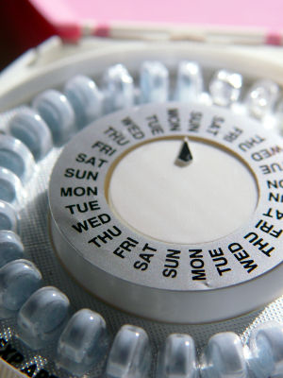
Contraception, IUDs, and Emergency Contraception
Notes:
Image Source: http://sp.life123.com/bm.pix/oral-contraceptives.s600x600.jpg

Slide 2
Science and the Bible
Ecclesiastes 8:17 then I saw all the work of God, that man cannot find out the work that is done under the sun. However much man may toil in seeking, he will not find it out. Even though a wise man claims to know, he cannot find it out.
Proverbs 18:17 The one who states his case first seems right, until the other comes and examines him.
Proverbs 25:2 It is the glory of God to conceal things, but the glory of kings is to search things out.

Slide 3
Biblical Principles
Human life is Sanctified and Dignified (John 15:13, John 3:16, 1 John 3:16, Rom. 5:8, 2 Pt. 3:9, Heb. 12:14, 1 Pt. 1:14-16)
Duty to respect embryonic human life (Matt. 7:12, 22:39, Luke 6:31)
  An embryo is a “biologically irreducible neighbor”
  The Golden Rule Applies

Slide 4
Biblical Principles
God prohibits the taking of innocent human life
  Matt. 5:21, 15:19
  Romans 1:29, Romans 13:9
Do not violate your conscience (Rom. 14:23b, 1 John 3:19-21) - conscientious objection

Slide 5
Biblical Principles
Human life is valued by God (Gen. 1:26,27, Ps. 8:6).
Those of old understood conception, pregnancy, and birth (Hos. 9:11, Jer. 20:14-18).
God’s love and value of human life is demonstrated both in creation and in Christ’s sacrificial death (Psalm 8:1-9, John 3:16, 17).
Man must love his neighbor. Fertilization is the irreducible earliest point of “neighbor” (Matt. 7:12, 22:39, Luke 6:31).
Children are gracious gifts to be valued by mankind (Gen. 33:5, Psalm 127:3).

Slide 6
Biblical Principles
Both the unborn in the womb and the born delivered from the womb are valued by God (Ex. 21:22-25, Ps. 139:13-17).
Human life is both sanctified and dignified (John 15:13, 1 John 3:16, Rom. 5:8, 2 Pt. 3:9, Heb. 12:14, 1 Pt. 1:14-16).
God prohibits the taking of innocent human life (Matt. 5:21, 15:19, Rom. 1:29, 13:9).
Mankind must inform and stay true to the conscience (Rom. 14:23b, 1 John 3:19-21).

Slide 7
The Science of fertilization and Ovulation

Slide 8
Cycle and Timing
Three Primary Systems – Brain, Ovaries, Uterus
Menstrual Cycle
  Day 1 – First day of Menstruation
  Roughly Day 14 – Day of Ovulation
Fertile – up to 5 days prior to ovulation and day of ovulation
  Sperm
    can travel to the fallopian tube in 5 minutes
    can live 5-6 days in the female reproductive tract
  Egg (Ovum)
    Must be fertilized within 12-24 hours

Slide 9
Ovulation
Ovulation – typically occurs day 14, when LH and FSH levels spike and a follicle (egg) is released.
Estimates
  Some estimate that as many as 1/3 to ½ of fertilized eggs do not implant in woman not on COCs (not the most reliable studies)

Slide 10
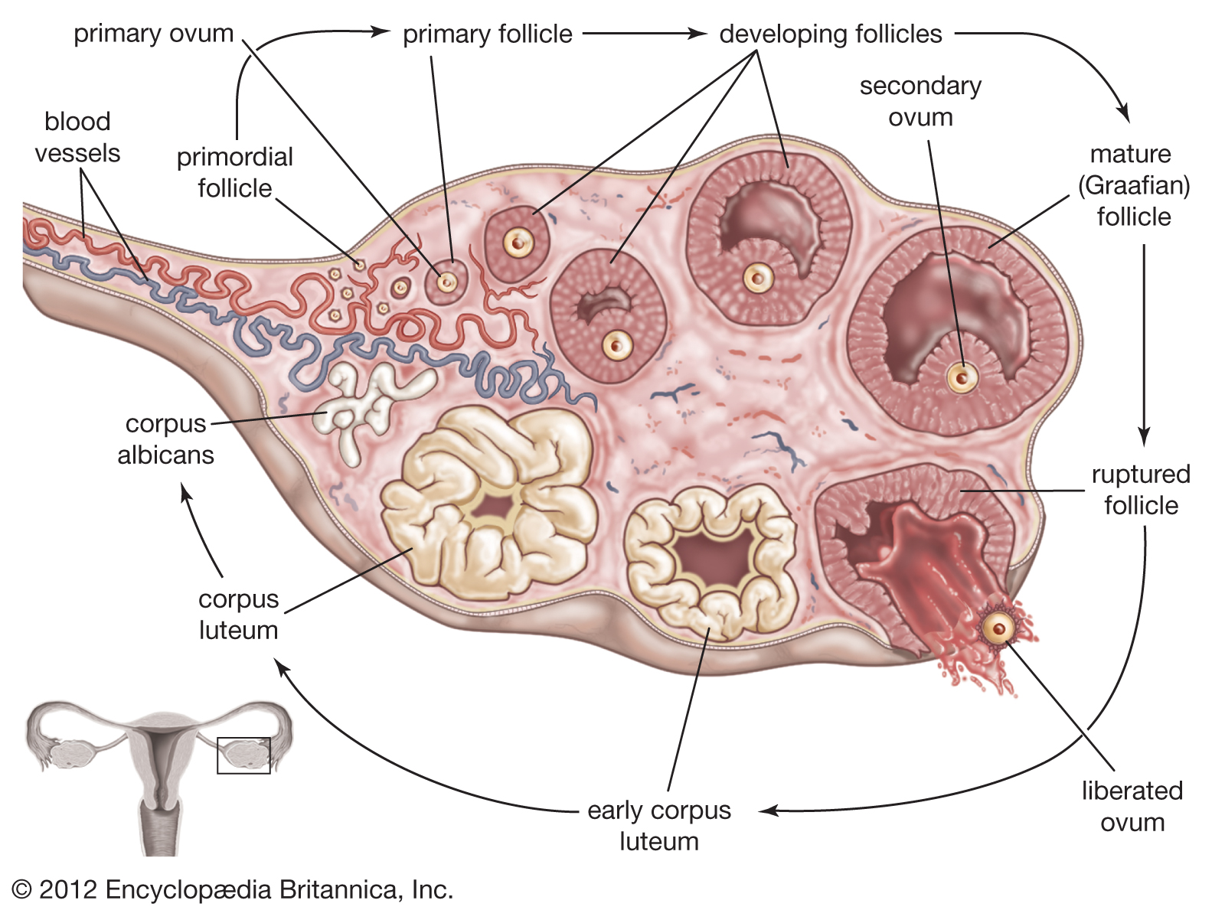
https://www.britannica.com/science/corpus-luteum/media/138543/99761

Slide 11
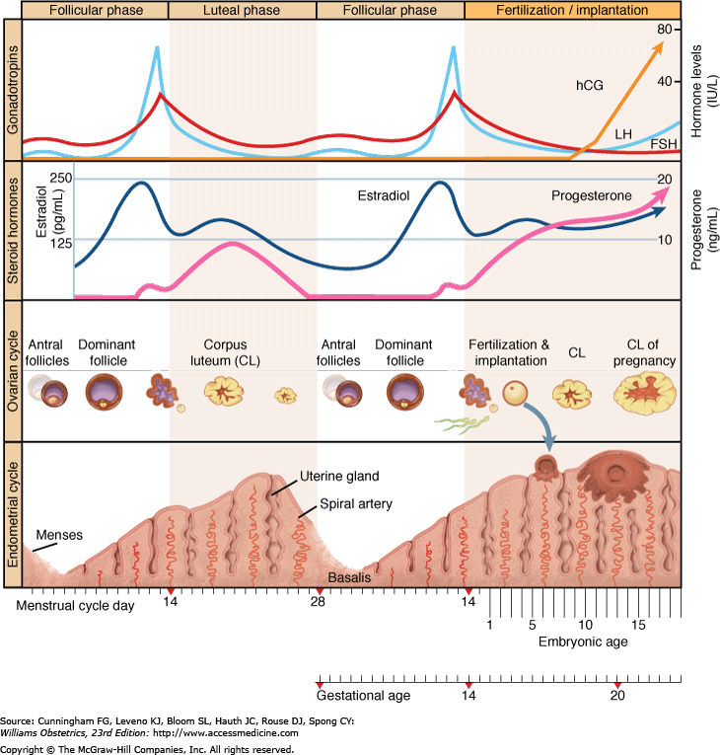
LH Surge

Slide 12
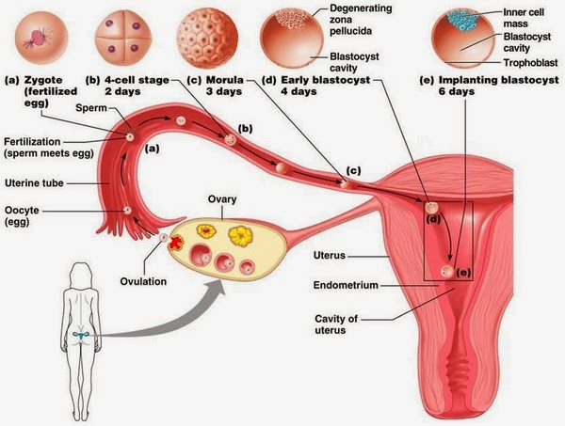
http://babygirlorboytolove.blogspot.com/2013/

Slide 13
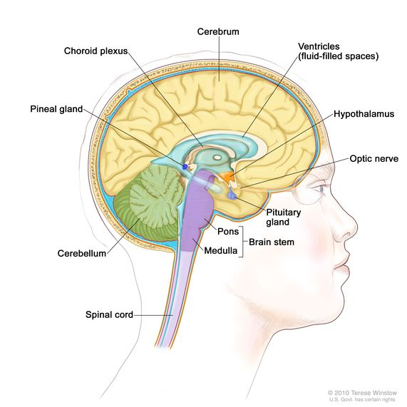
https://www.cancer.gov/publications/dictionaries/cancer-terms/def/hypothalamus

Slide 14
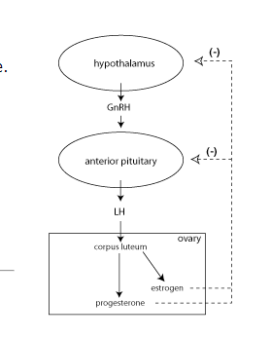
“The primary mechanism of action of hormonal contraceptives is that they suppress the secretion of gonadotropins (follicle stimulating hormone, FSH and luteinizing hormone, LH) through negative feedback inhibition.”
https://courses.washington.edu/conj/bess/contraception/contraception.htm

Slide 15
Language of Birth Control

Slide 16
What Is Meant by Birth Control?
Sterilizations - tubal ligation, male sterilization (vasectomy), fallopian implants (Essure).
Oral contraceptives pills (OCPs).
  Combination – Mono-, Bi-, Tri-, 4-Phasic
Contraceptive Patch (OrthoEvra)
Vaginal Rings (Nuvaring)
Injectables (Depo-Provera, Lunella [no longer available])
Surgical Implant (Implanon)
Barriers/ Blockades: diaphragms, condoms, sponge, cervical cap
Spermacide foam, film, or gels
Intrauterine Devices: copper Intrauterine Devices (IUDs), drug releasing IUDs (Mirena)
Periodic Abstinence: calendar rhythm, natural family planning
Emergency Contraception, “Morning After Pill”, “Post coital Contraception”
Abortifacient: Mifeprex (Mifepristone, RU-486) 600mg dose
Ella (ulipristal acetate; now approved in the US); known as Ellaone in Europe
Facts and Comparisons, (St. Louis 2011).

Slide 17
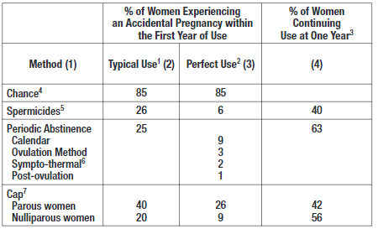
Efficacy of Agents
Parous – Having Given Birth, Nulliparous – never have given birth
https://hcp.paragard.com/wp-content/uploads/sites/2/2018/09/ParaGard-PI.pdf

Slide 18
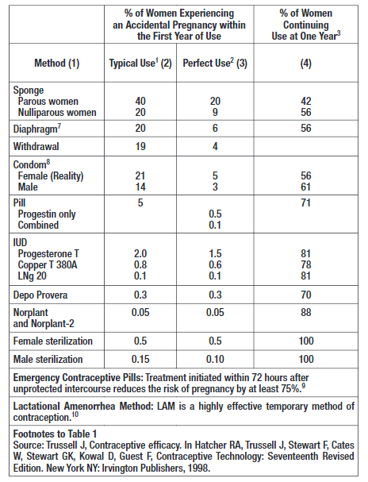
Notes:
https://hcp.paragard.com/wp-content/uploads/sites/2/2018/09/ParaGard-PI.pdf

Slide 19
Potential Mechanisms
Prefertilization
  altering the cervical mucus, changing vaginal pH, impeding sperm, and preventing ovulation
    Phexxi is a non-hormonal contraceptive gel that alters vaginal pH to make it too acidic for sperm to survive
Postfertilization
  impede early embryo (blastocyst) implantation.

Slide 20
The Language of Birth Control
“If you can find the right terminology,” she said, “you can change the way people think.” said Carmen Fought, linguist at Pitzer College
Weil, Elizabeth. "West Palm Woman Calls Faux Spouse Her ‘Fusband’, What Do You Call an Unmarried Partner When Girlfriend/Boyfriend Doesn’t Sound Right?" The Palm Beach Post: Cox Publication, 2013. https://www.palmbeachpost.com/lifestyles/west-palm-woman-calls-faux-spouse-her-fusband/n0IvmJwy3swUldiY094dEL/

Slide 21
Confusing/ Controversial Language
Birth Control – Generally not controlling labor and delivery
Clarify
  Conception: Which Definition?
    Fertilization? or
    Implantation ? or
    Both?

Slide 22
Confusing/ Controversial Language
Clarify
  Pregnancy: Which View?
    Fertilization view
    Implantation view
  Contraception – Does one mean:
    Prevent ovulation?
    Prevent fertilization?
    Prevent implantation?
    Causing embryo detachment?
    One or more of the above?

Slide 23
The Language of Birth Control
An established pregnancy is defined by the United States Food and Drug Administration/ National Institutes of Health and the American College of Obstetricians and Gynecologists (ACOG) as beginning with implantation. Trussell J, Jordan B. Mechanism of action of emergency contraceptive pills. Contraception. 2006 Aug;74(2):87-9. Epub 2006 May 19.
Do most women believe this when walking into the prescriber’s office? Do they hold to the same definition?

Slide 24
The Morality of Intrauterine Devices (IUDs)

Slide 25
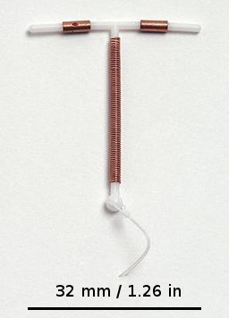
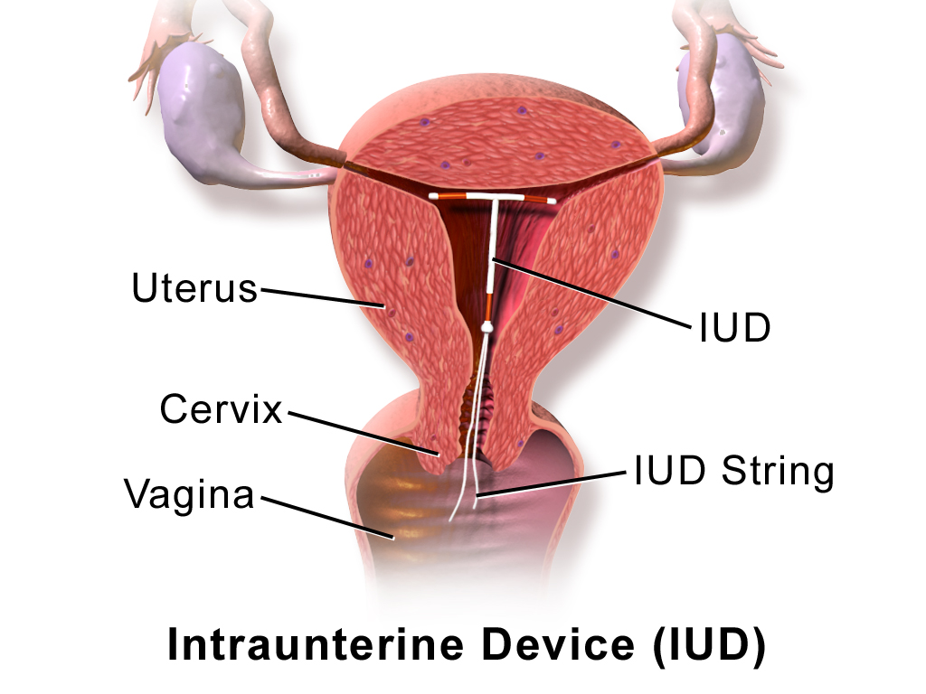
What is an IUD?
By BruceBlaus. When using this image in external sources it can be cited as:Blausen.com staff (2014). "Medical gallery of Blausen Medical 2014". WikiJournal of Medicine 1 (2). DOI:10.15347/wjm/2014.010. ISSN 2002-4436. - Own work, CC BY 3.0, https://commons.wikimedia.org/w/index.php?curid=30462644
https://commons.wikimedia.org/wiki/File:Multiload-Gynefix-Paragard.jpg
Referred to as LARCs – Long-acting reversible contraceptives
Notes:
https://www.kff.org/womens-health-policy/fact-sheet/intrauterine-devices-iuds-access-for-women-in-the-u-s/

Slide 26
What Products are Available in America?
Paragard ®
  Copper IUD – provides contraception for 10 years, pregnancy rate of 1/100
Mechanism “The contraceptive effectiveness of ParaGard is enhanced by copper continuously released into the uterine cavity. Mechanism(s) by which copper enhances contraceptive efficacy include interference with sperm transport and fertilization of an egg, and possibly prevention of implantation.” (https://hcp.paragard.com/wp-content/uploads/sites/2/2018/09/ParaGard-PI.pdf)
Used historically for post coital contraception = post sex = “emergency contraception”

Slide 27
What Products are Available in the U.S.?
Mirena (Levonorgestrel-releasing Intrauterine system) 52mg
Kyleena (Levonorgestrel-releasing Intrauterine system) 19.5mg
Skyla (Levonorgestrel-releasing Intrauterine system) 13.5mg
Liletta (Levonorgestrel-releasing Intrauterine system) 52 mg

Slide 28
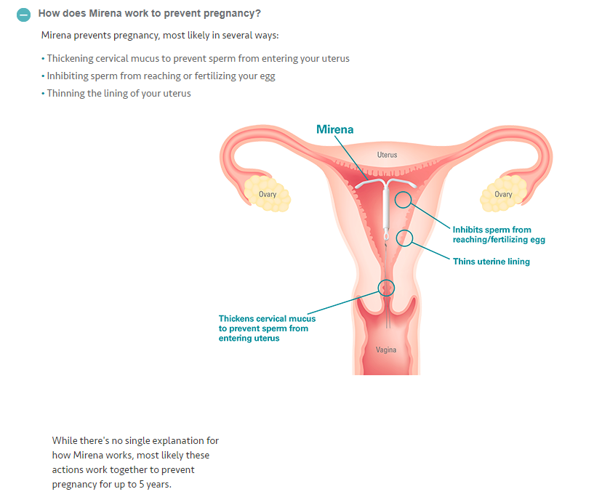
Mirena
Mirena
https://www.mirena-us.com/q-and-a/

Slide 29
“Mechanisms of action of intrauterine devices: update and estimation of postfertilization effects” (2002)
“There are many potential mechanisms of action for the intrauterine device (IUD), which vary by type of IUD (inert, copper, or hormonal). This paper reviews the evidence for each potential mechanism of action. On the basis of available data for fertilization rates and clinical pregnancy rates, the relative contribution of mechanisms acting before or after fertilization were quantitatively estimated. These estimates indicate that, although prefertilization effects are more prominent for the copper IUD, both prefertilization and postfertilization mechanisms of action contribute significantly to the effectiveness of all types of intrauterine devices.
Stanford, J, Mikolajczyk, R., Mechanisms of action of intrauterine devices: update and estimation of postfertilization effects., Am J Obstet Gynecol. 2002 Dec;187(6):1699-708. https://www.ncbi.nlm.nih.gov/pubmed/12501086

Slide 30
“Intrauterine devices and intrauterine systems”
“From a public health viewpoint, the intrauterine device (IUD) is the most widely used contraceptive method in the world. Prevalence rates range among countries from 2 to 80% of contraceptive users. During 5 years of IUD use, pregnancy occurs in less than 2 per 100 insertions. Bleeding and pain are the most common reasons for removal rates of 10% in the first year and up to 50% within 5 years. The contraceptive effects of IUDs may be due to a sterile inflammatory reaction in the endometrial cavity which interferes with sperm function, so that fertilization is less likely to occur. IUDs also interfere with implantation but the extent to which this contributes to their contraceptive action is unknown. . . .
ESHRE Capri Workshop Group, Intrauterine devices and intrauterine systems, Hum Reprod Update. 2008 May-Jun;14(3):197-208. https://www.ncbi.nlm.nih.gov/pubmed/18400840

Slide 31
“Emergency contraception -- mechanisms of action”
“The main mechanism of action of the Cu-IUD is to prevent fertilization through the effect of Cu ions on sperm function. In addition, if fertilization has already occurred, Cu ions influence the female reproductive tract and prevent endometrial receptivity. Based on this review of the published literature, it can be concluded that existing methods used today for EC act mainly through inhibition of ovulation or prevention of fertilization. An additional effect on the endometrium as occurs for the Cu-IUD, but not for the hormonal alternatives, seems to increase the efficacy of the method.”
Gemzell-Danielsson K¹, Berger C, P G L L., Emergency Contraception – mechanism of action. Contraception. 2013 Mar;87(3):300-8, https://www.ncbi.nlm.nih.gov/pubmed/23114735
Notes:
Conflicting Study: https://www.contraceptionjournal.org/article/S0010-7824(07)00081-9/fulltext

Slide 32
Abortion and “Emergency” Contraception
Postcoital Contraception

Slide 33
Abortion in the U.S.
Mifeprex® – Mifepristone (RU-486)
  Blocks Progesterone needed to maintain pregnancy
Cytotec ® - Misoprostol
  Causes uterine contractions to expel embryo
MORALLY PROBLEMATIC
http://www.earlyoptionpill.com/

Slide 34
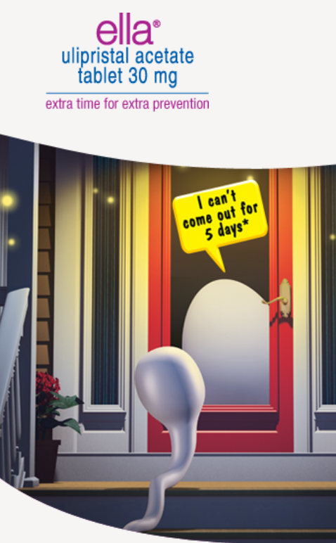
Ella ® Ulipristal Acetate (UPA) 30mg
Delays or Prevents Ovulation - progesterone agonist
May prevent attachment to the uterus - progesterone antagonist
MORALLY PROBLEMATIC

Slide 35
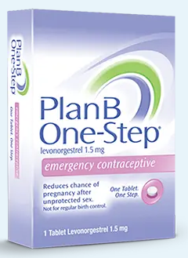
Emergency Contraception - Plan B® One- Step
“Morning After Pill”
Impedes Sperm and Prevents Ovulation
If taken on or after ovulation, unlikely to cause detachment
If taken when the egg is advanced in size, prior to ovulation the timing of uterus could be thrown off, preventing implantation
http://www.planbonestep.com/

Slide 36
Non-Hormonal Option

Slide 37
Non-hormonal Option - Phexxi Gel
Not a spermicide, but lactic acid, citric acid, K Bitartrate
Inserted/ applied 1 hr prior to intercourse, repeated for each act of intercourse
How it works
  Typically
    Vaginal pH is 3.5-4.5 (acidic)
    Semen increases pH to 6.5-7.2 (closer to neutral 7) allowing sperm motility
  With the drug – vaginal pH is maintained in the acidic range decreasing sperm motility
    Studies show post-coitus pH<5
An Early report 86-93% effective, Post-hoc study = 99%
Phexxi.com
Notes:
https://www.empr.com/home/news/post-hoc-analysis-shows-phexxi-prevented-99-of-pregnancies-per-act-of-intercourse/
https://www.prnewswire.com/news-releases/phexxi-prevented-99-of-pregnancies-per-act-of-intercourse-in-a-post-hoc-analysis-of-phase-3-ampower-clinical-trial-data-301569515.html

Slide 38
Oral Contraception

Slide 39
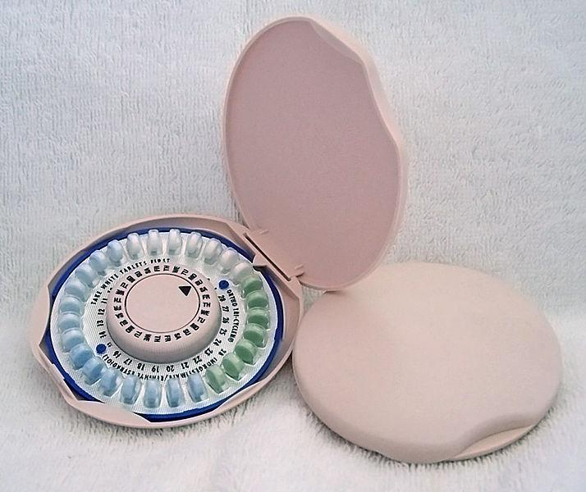
Ortho Tri-Cyclen ®
Combination Oral Contraceptive (COCs)
http://commons.wikimedia.org/wiki/File:Ortho_tricyclen.jpg

Slide 40
How Do COCs Work?
- Ortho Tri-Cyclen ®
“Combination oral contraceptives act by suppression of gonadotropins. Although the primary mechanism of this action is inhibition of ovulation, other alterations include changes in the cervical mucus (which increase the difficulty of sperm entry into the uterus) and the endometrium (which reduce the likelihood of implantation).”
  http://www.accessdata.fda.gov/drugsatfda_docs/label/2005/021690lbl.pdf

Slide 41
What We Don’t Have
"fertilization marker“
  “to determine when fertilization occurs and to look at outcomes of fertilization on and off of hormonal contraceptives. Such a fertilization marker does not exist.” (Donna Harrison)
Hope for the Future
  Male Fertility Agents

Slide 42
What Else Would Deny any Possibility of an Abortion Effect?
More Embryonic Studies = Destruction of Human Life

Slide 43
What You Should Know
Breakthrough Ovulation Estimates
  1.5% to 16.8%
But Ovulation does not demand the conclusion
  That the egg was fertilized
  That the fallopian tube transported the egg
  That the fertilized egg failed to implant
In Fact
  Some women do get pregnant on the pill and stay pregnant on the pill

Slide 44
Conclusion
Can we prove that COCs do not prevent implantation of a fertilized egg?
  Absolutely in these cases
    Every time a woman fails to ovulate
    Every time sperm is impeded
    Every time she gets pregnant on the pill
Most of the time it works by preventing ovulation

Slide 45
Conclusion
Can we prove that COCs never cause a failure of implantation?
  NO
    This burden of proof is too high and virtually non-existent in science
  So
    Decisions are made with less than ideal and exhaustive information

Slide 46
Points to Remember COCs
Alterations of the cervical mucus that impede sperm
COCs Primarily work by Preventing Ovulation
  Especially the Higher Estrogen Dose (30mcg or more) Products
Take within the same 3-hour window each day

Slide 47
Conclusion
We should not be dismissive of data on
  Post follicle rupture
  Changes in fallopian tubes, post fertilization
  IVF data that demonstrates post fertilization needs
  Pregestational needs for implantation (preventing LH surge midcycle)
  Endometrial receptivity studies
If demonstrative evidence becomes available that implantation with the use of oral contraceptive is conclusive, all should have the courage to abandon the use (Matt. 7:12).

